Slide 1

Expanding the Reach of the EHR Through Data Integration
Department of Biostatistics, Epidemiology and Informatics
Yong Chen, Ph.D.
Twitter: @chenyong1203
@PennCIL_lab
December 1st, 2020
https://penncil.org/
Notes:
Everyone here needs samples. Let me tell you how to get 500k samples for free.

Slide 2
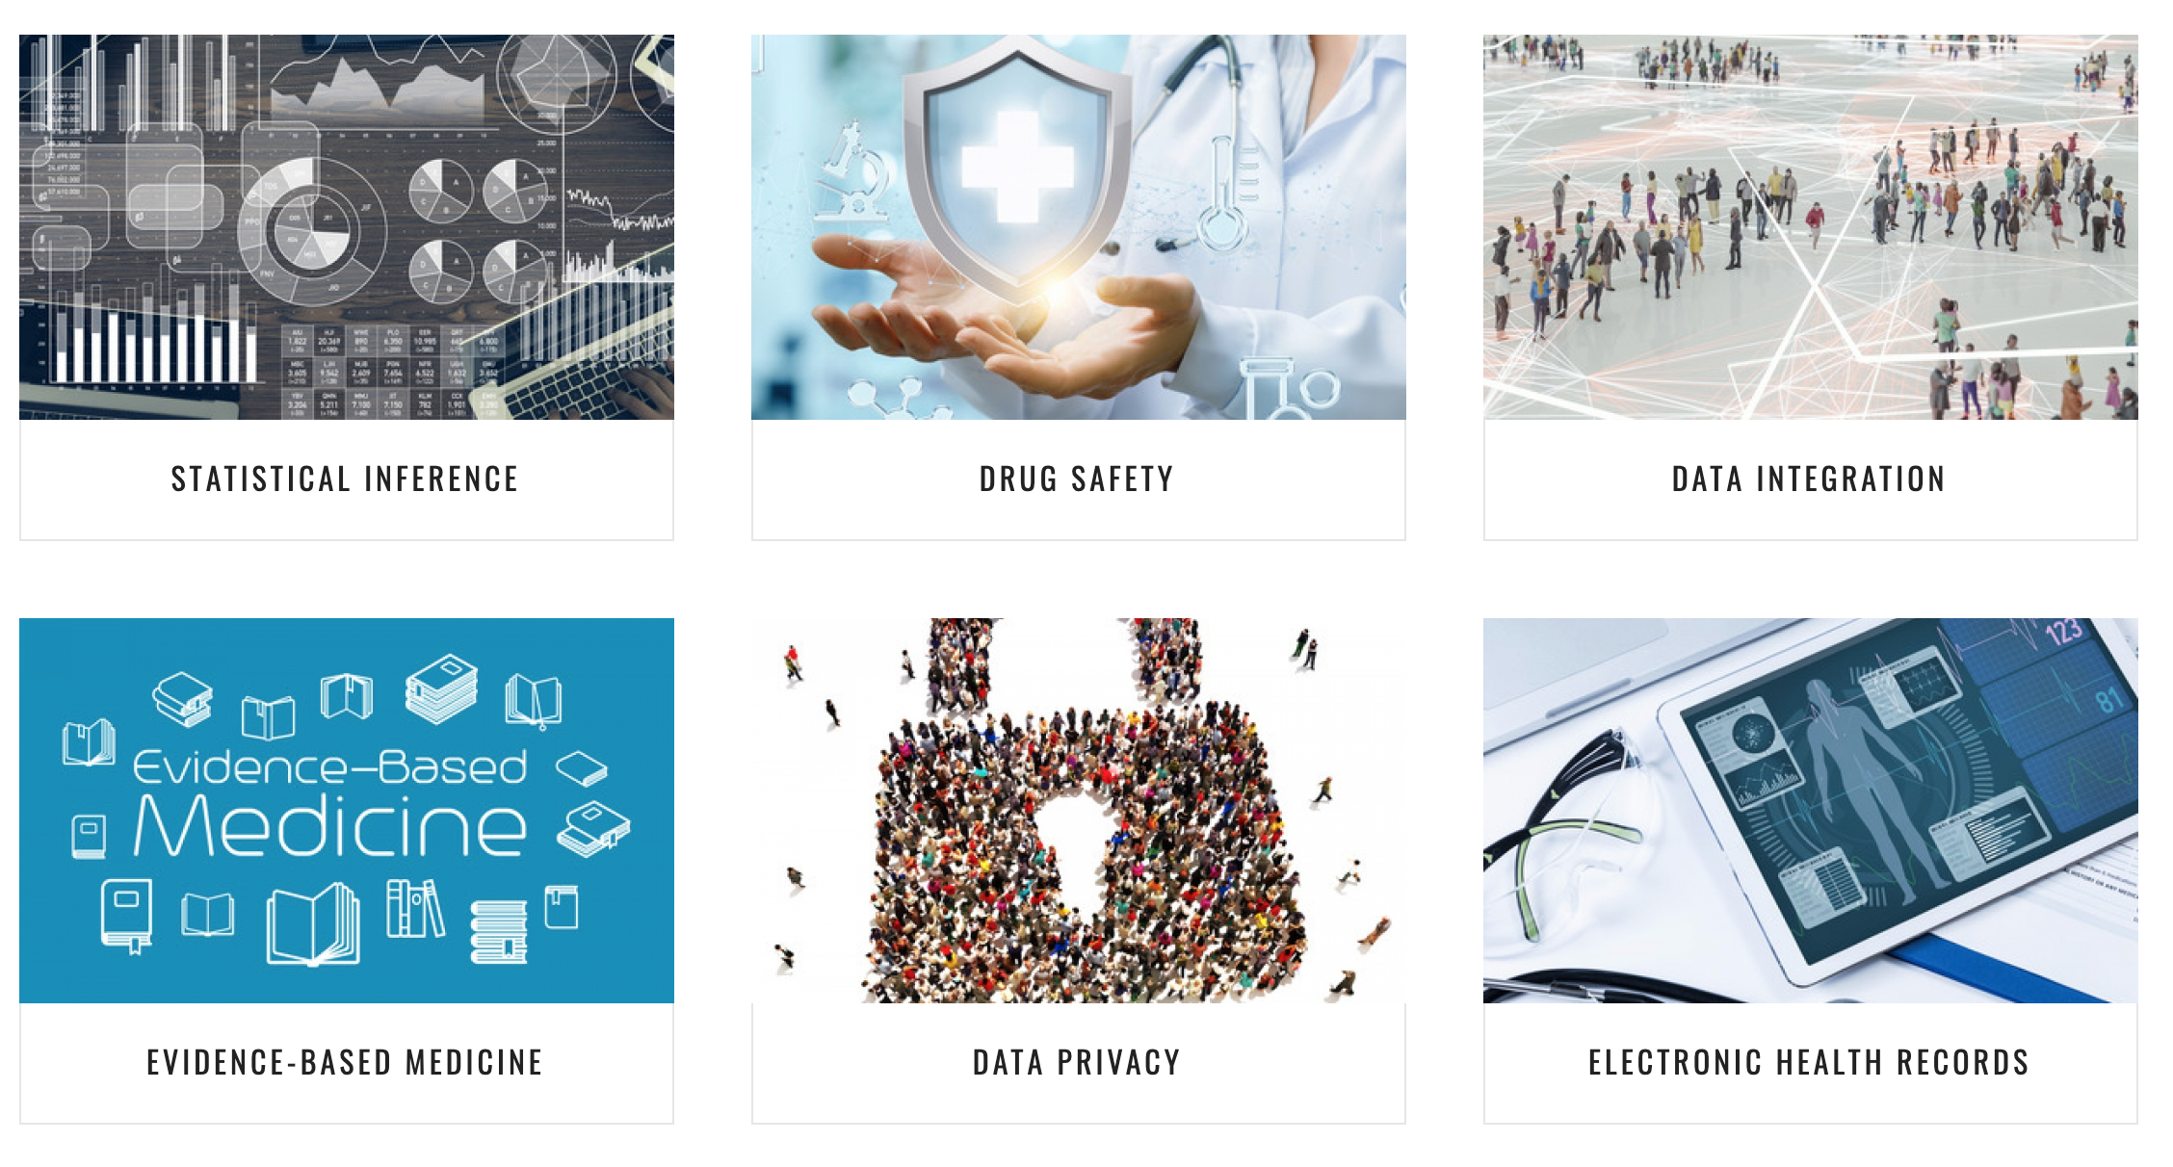
Our Research Areas
Notes:
Everyone here needs samples. Let me tell you how to get 500k samples for free.

Slide 3
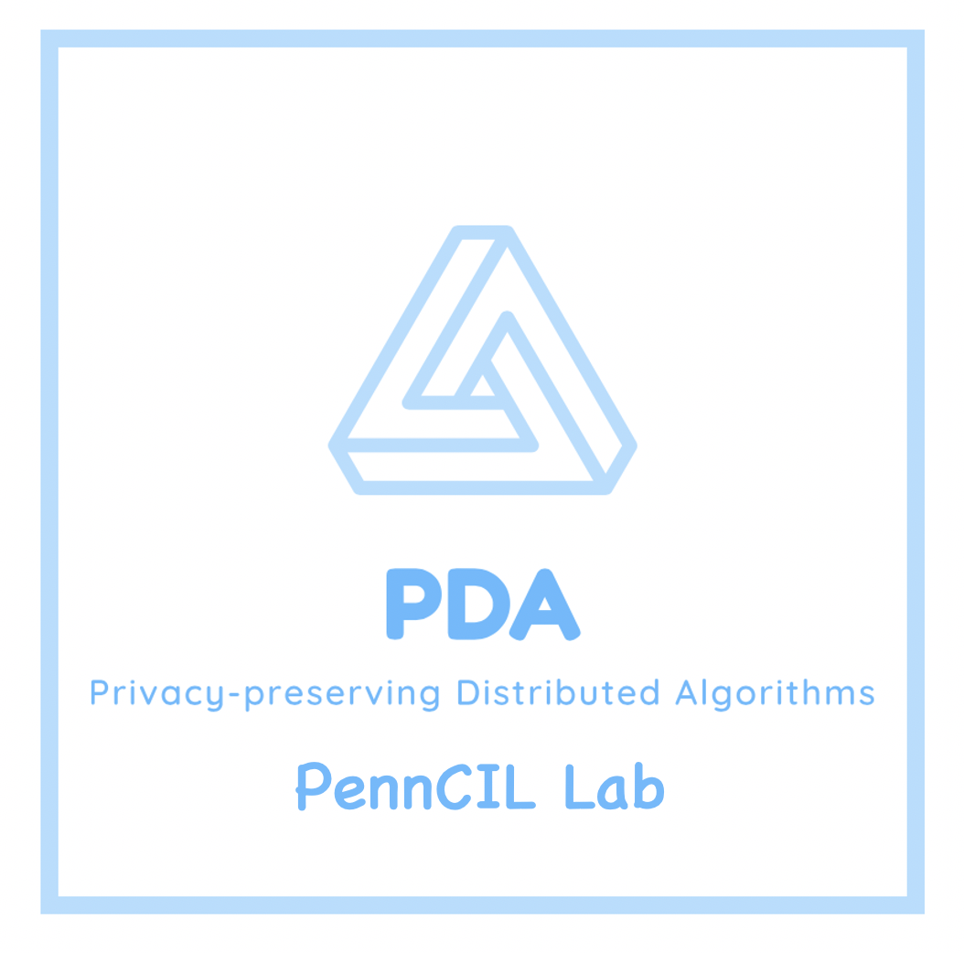
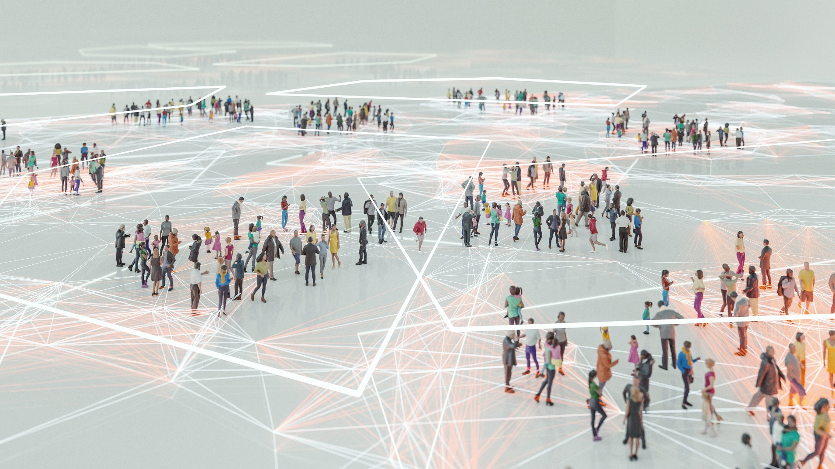

Slide 4

Acknowledgements
PennCIL Alumni: Rui Duan
(Harvard University, Assistant Professor of Biostatistics)
PennCIL Group Members:
Mackenzie Edmondson, Ruowang Li, Xiaokang Liu,
Chongliang Luo, Jessie Tong, Yuchen Yang
Penn/CHOP Collaborators:
Robert Baldassano, Mary Boland, Christopher Forrest,
Ruben Gur, John H. Holmes, Henry Kranzler, Rebecca Hubbard,
Ebbing Lautenbach, Peter Merkel, Jason Moore, Jeff Morris,
Ronen Stein
OHDSI Collaborators:
Martijn Schuemie, Patrick Ryan, Jesse A Berlin
Cornell University:
Yang Ning

Slide 5

Our Partners

Slide 6

Real-World Evidence (RWE)
Information derived from sources outside typical clinical research settings (Sherman et al. 2016 NEJM)
  Electronic health records (EHRs)
  Claims/billing data
  Product/disease registries
  Mobile devices/applications (e.g. wearables)

Slide 7
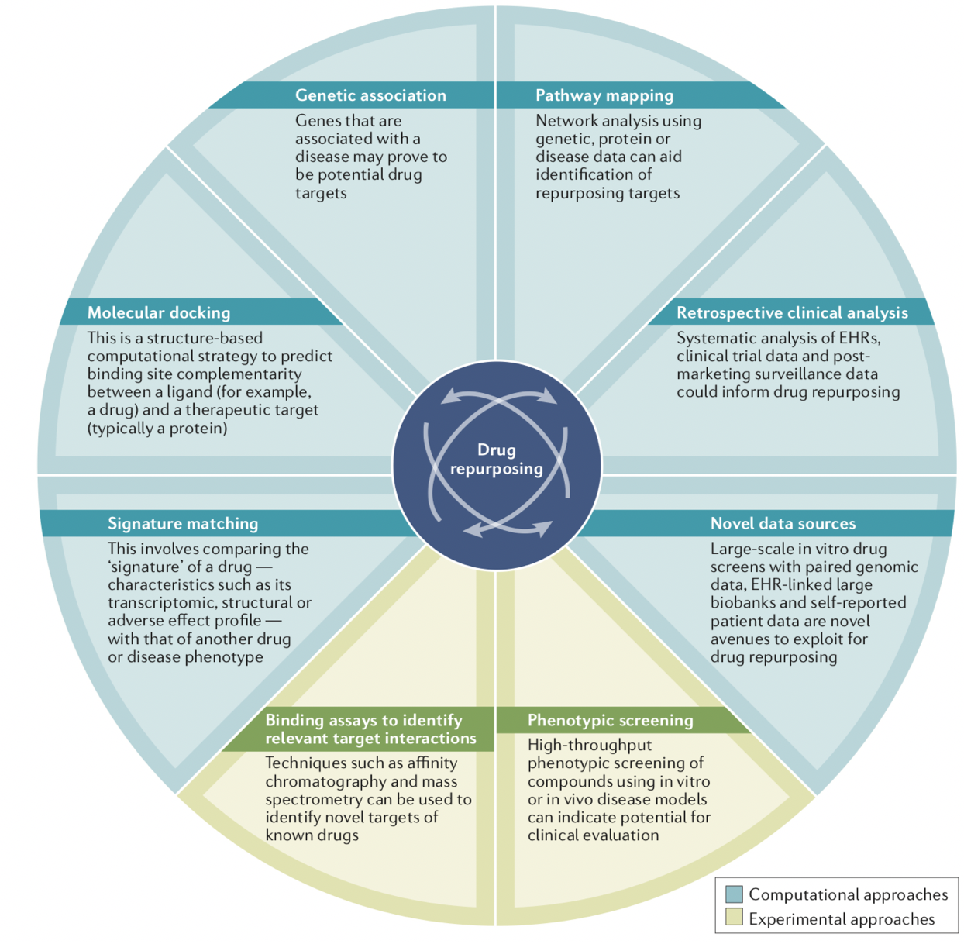
Real-World Evidence: Potential Applications
Drug repurposing
  Cost-effective
  Saves (a lot of) time!
Pushpakom, Sudeep, et al. "Drug repurposing: progress, challenges and recommendations." Nature Reviews Drug Discovery 18.1 (2019): 41
Notes:
Cost-effective: Using existing drug for new indication can save a lot of money that would be invested in development, as well as a lot of time that would be spent developing a new drug.

Slide 8
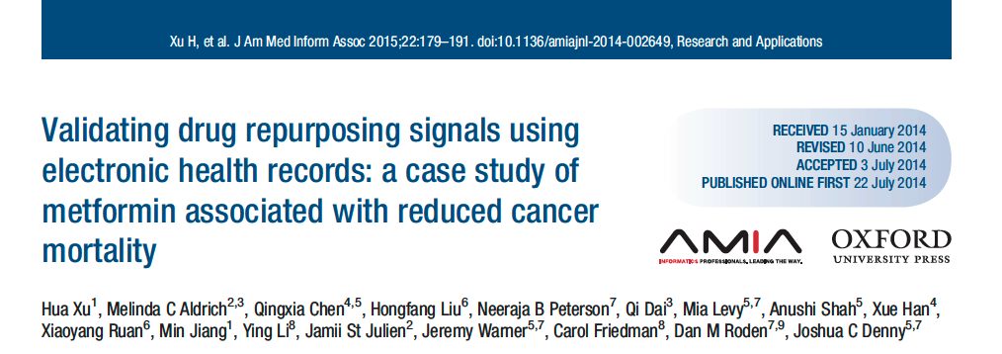
Drug Repurposing Examples
Notes:
Metformin: a treatment for type 2 diabetes
Association b/w metformin & reduced mortality in cancer patients, suggesting potential as a form of chemotherapy that could be validated in a clinical trial.

Slide 9
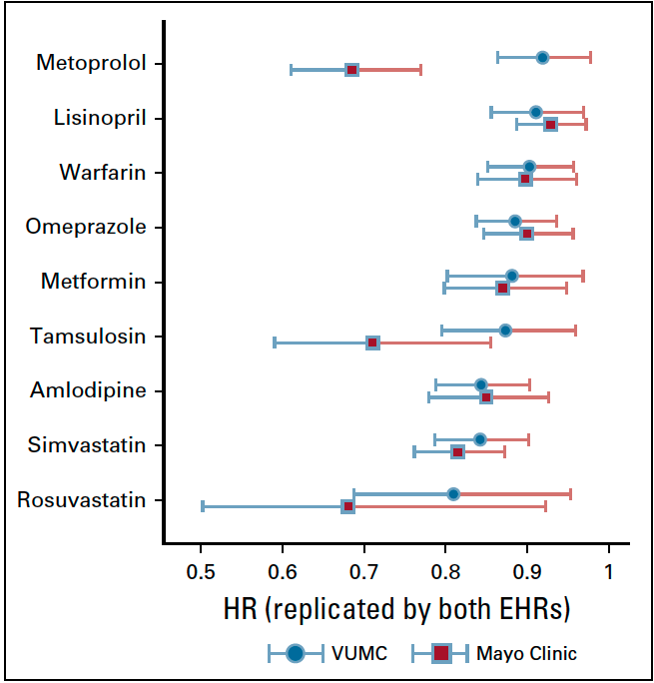
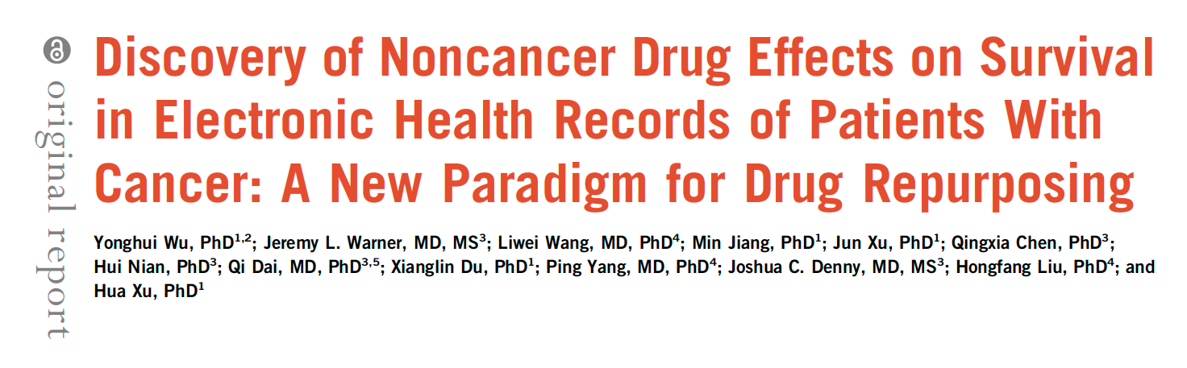
Drug Repurposing Examples
Notes:
Simlar example
Authors mined EHRs in two health systems to find noncancer drugs that could potentially be used to treat cancer.
Shows potential for RWE to potentially save a lot of time and money that would be spent developing entirely new drug

Slide 10

Real-World Evidence: Potential Applications
Pharmacovigilance
  Post-market safety surveillance
  Are there long-term effects not captured in clinical trial?

Slide 11

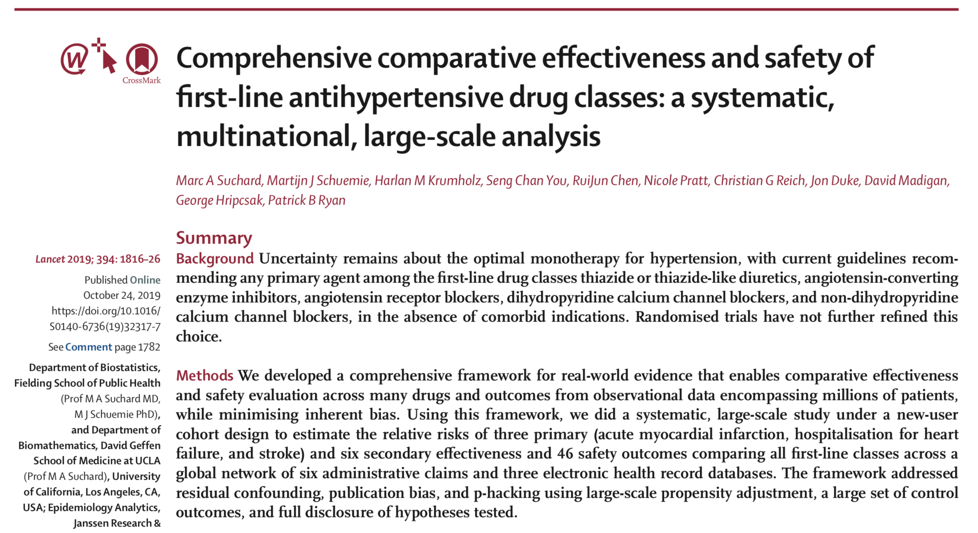
Pharmacovigilance Example
Notes:
One example of many large studies using observational data to look at pharmacovigilance.
Authors used observational data to look at both comparative effectiveness and safety of drugs for treating hypertension.

Slide 12
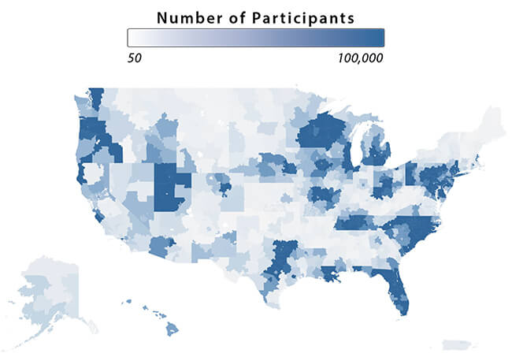
Distributed Health Data Networks
No data centralization: data holders maintain control over data
  Participants adopt common data model (CDM)
  Analyses performed distributively (email, central server, etc.)
  No patient-level data transfer
Sentinel Initiative
  FDA: Post-market safety surveillance
  16 data partners contribute billing data, EHRs
PCORnet
  National patient-centered clinical research network for comparative effectiveness research
  68 million patients
http://pcornet.org
Notes:
Out of necessity to perform large studies without sharing patient-level data across institutions, several distributed data networks have been formed in recent years.
PCORI: Patient-Centered Outcomes Research Institute

Slide 13

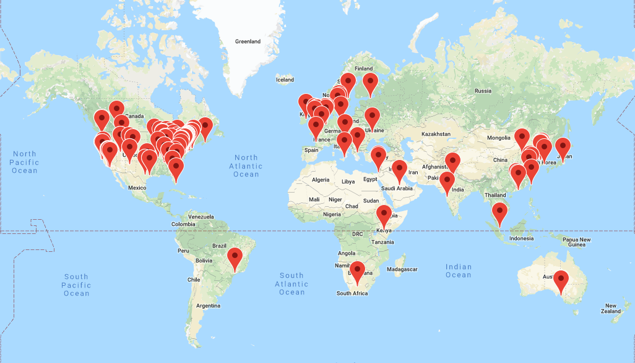
Why is it important?
‘s global research community

Slide 14
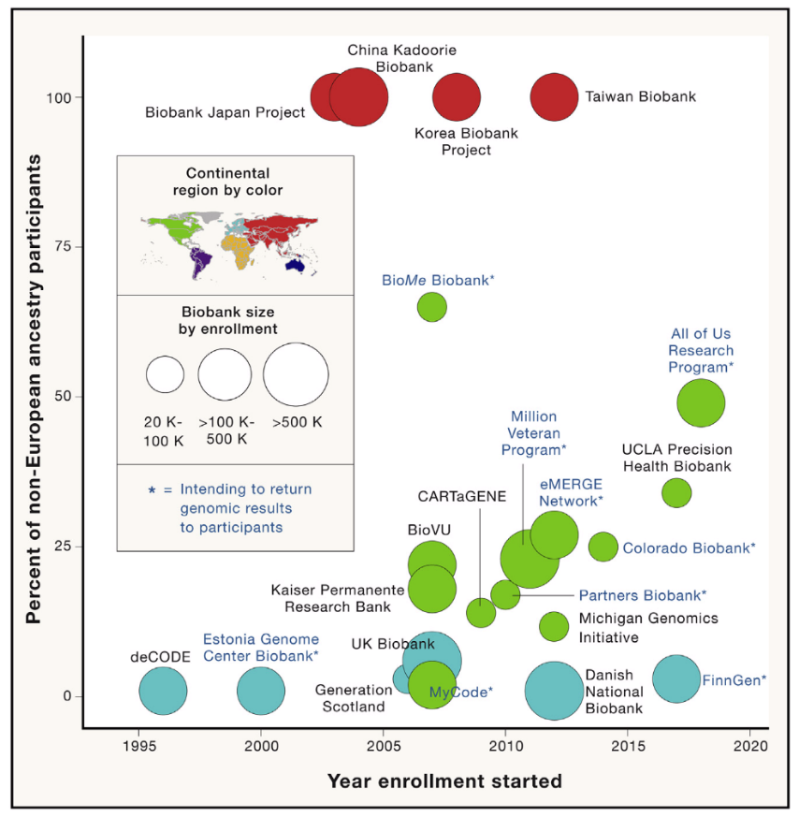

Why it is important?
Biobanks (Worldwide)
EHR + Genetics

Slide 15


Promise and challenges of multi-site studies
Covers broader population
  Results are more generalizable
  Better statistical power
  Opportunities of studying rare diseases
Sharing individual-patient level data is challenging
Ecosystem of bringing together expertise from different investigators
Need iterative collaboration/coordination among investigators from different institutes
(consuming lots of time, effort, funding)

Slide 16
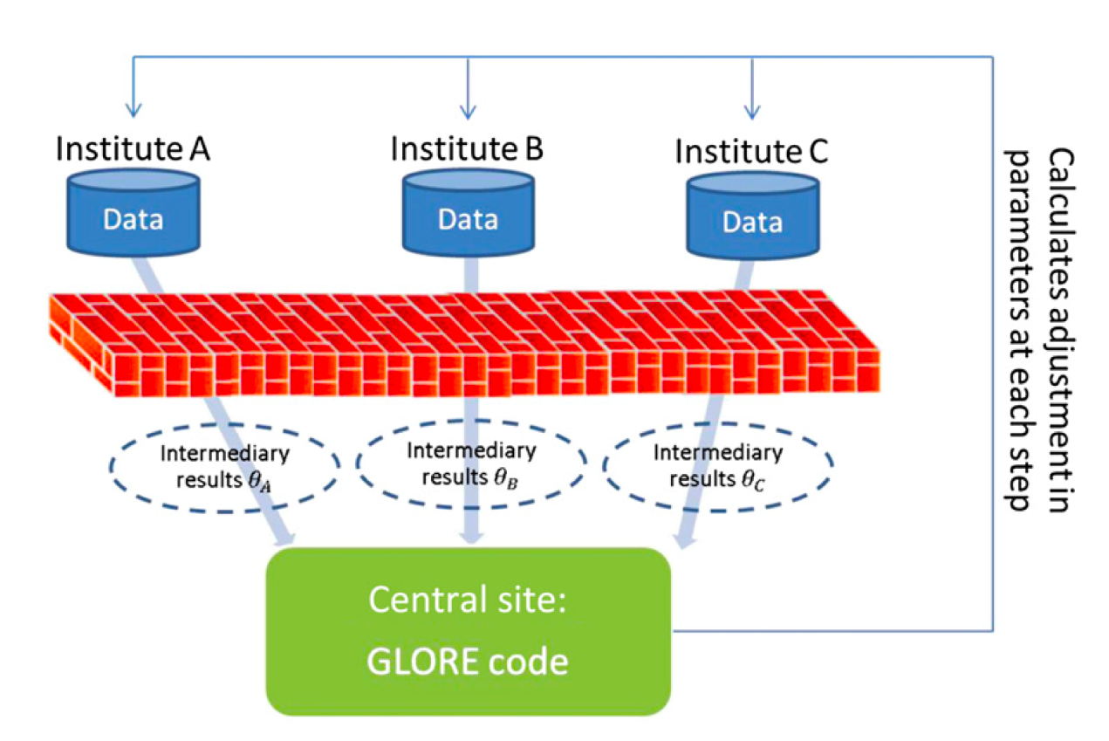
Current algorithms of distributed analysis
Lossless --- obtain the identical results as the combined analysis
  For simple linear regression
    Distributed linear regression (Chen et al. 2006)
  For non-linear regressions, iterative algorithms are needed
    Binary outcome: Grid Binary LOgistic REgression (GLORE) (Wu et al. 2012)
    Time-to-event outcome: WebDISCO: a Web service for distributed Cox model (Lu et al. 2015)
Wu et al. 2012, JAMIA
One-shot (non-iterative) --- only requires the collaborative sites to exchange aggregated data once
  Averaging local estimates
    Meta-analysis, distributed PCA (Fan et al. 2018), distributed LDA (Lu et al. 2019), ....
  Surrogate likelihood (Jordan et al. 2018)

Slide 17
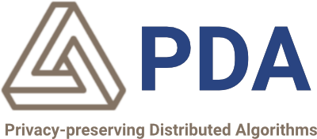
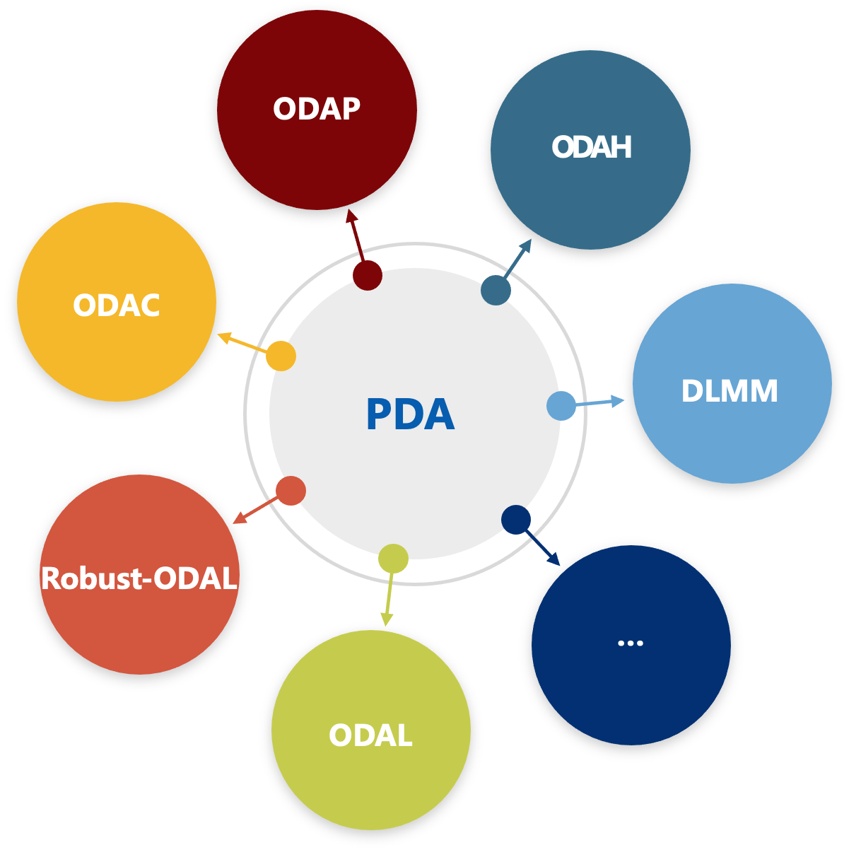
: a solution for next generation data sharing

Slide 18

Our Goal
  Safe --- protect patient-level information
  Accurate --- provide estimates which are close to the pooled analysis results
  Efficient --- no iterative communication across collaborating sites

Slide 19


Inspiration: an interesting observation – unique architecture of DRN
An investigator at a hospital do have access to the patient-level data of that hospital
Collaborating hospitals can share aggregated data

Slide 20
Can we use local hospital’s patient-level data and collaborating hospitals’ aggregated data to do multi-site data analysis?

Slide 21

ODAL
One-shot Distributed Algorithm for Logistic Regression

Slide 22
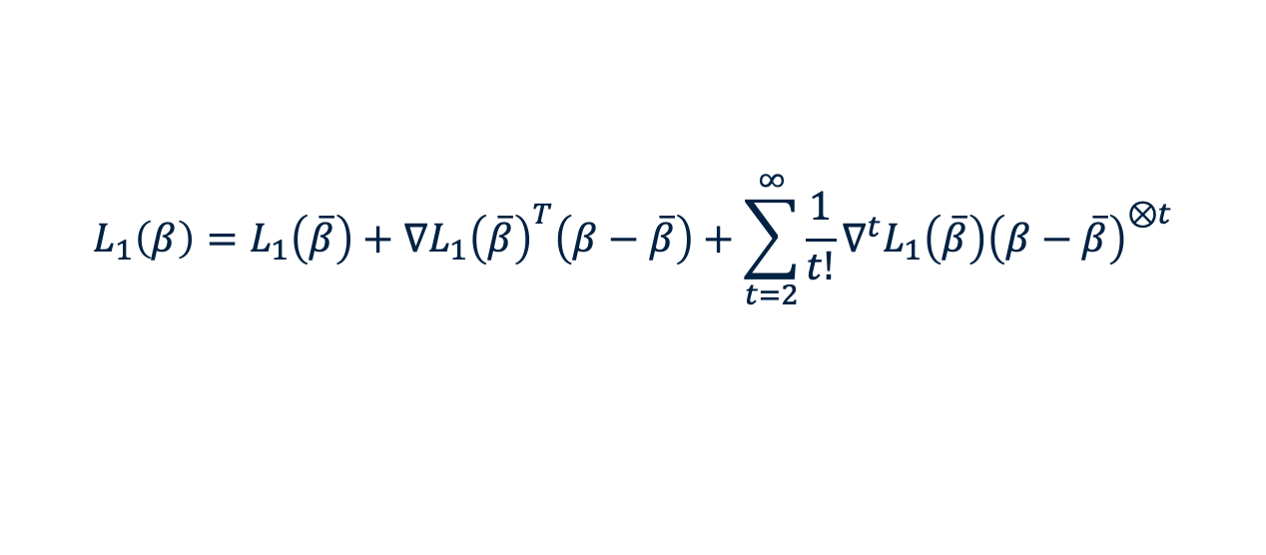
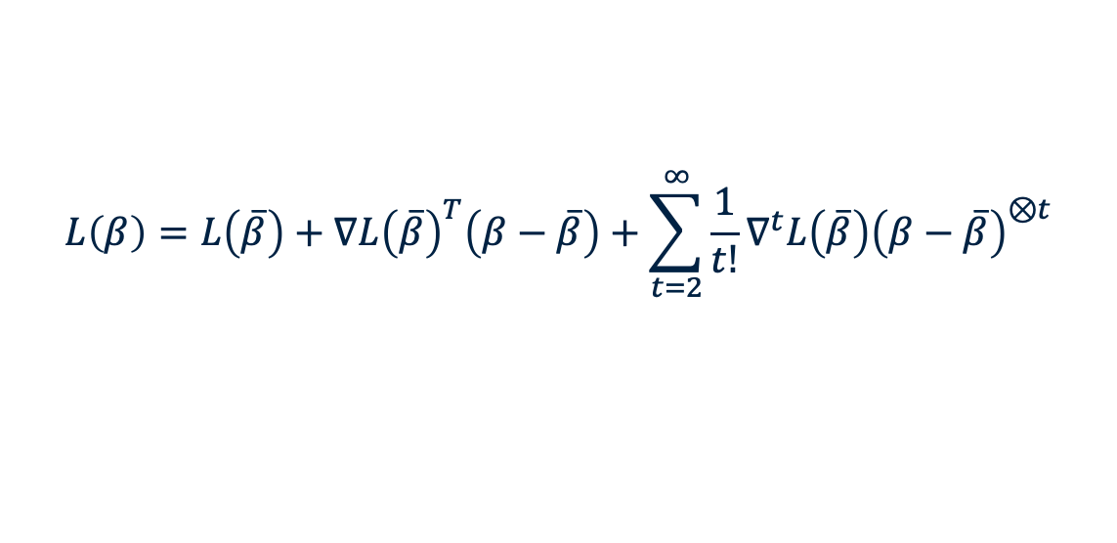
The surrogate likelihood (SL) approach
For some given initial value $\overline{β}$, consider Taylor expansion for the multi-site likelihood
$$L\left(β\right)=L\left(\overline{β}\right)+∇L{\left(\overline{β}\right)}^{T}\left(β−\overline{β}\right)+\sum_{t=2}^{∞}{\frac{1}{t!}}∇^{t}L\left(\overline{β}\right){\left(β−\overline{β}\right)}^{⊗t}$$
For some given initial value $\overline{β}$, consider Taylor expansion for the local likelihood
$$L_{1}\left(β\right)=L_{1}\left(\overline{β}\right)+∇L_{1}{\left(\overline{β}\right)}^{T}\left(β−\overline{β}\right)+\sum_{t=2}^{∞}{\frac{1}{t!}}∇^{t}L_{1}\left(\overline{β}\right){\left(β−\overline{β}\right)}^{⊗t}$$
Surrogate likelihood
${\tilde{L}}^{1}\left(β\right)$ = $L_{1}\left(β\right)+\{∇L\left(\overline{β}\right)−∇L_{1}{\left(\overline{β}\right)\}}^{T}β$

Slide 23
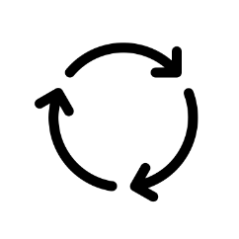







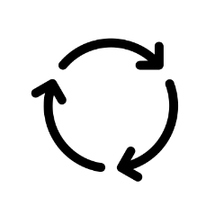







ODAL step-by-step illustration:
1a) Obtain a local initial value
1b) Broadcast the initial value to the collaborating sites
$$\overline{β}$$
$$\overline{β}$$
…
…
Site 1 (lead site) has patient-level data
Site 2
Site 3
Site K
$∇L_{2}\left(\overline{β}\right)$
$$∇L_{3}\left(\overline{β}\right)$$
$$∇L_{K}\left(\overline{β}\right)$$
2) Run a program, and send the aggregated data to Site 1
$${\tilde{L}}^{1}\left(β\right)$$
3) Construct surrogate likelihood at site 1
4) Obtain the final estimate
$${\tilde{β}}^{1}$$

Slide 24
ODAL advantages:

Slide 25
Recap
ODAL
binary outcome
Next:
time-to-event outcome
1
2

Slide 26
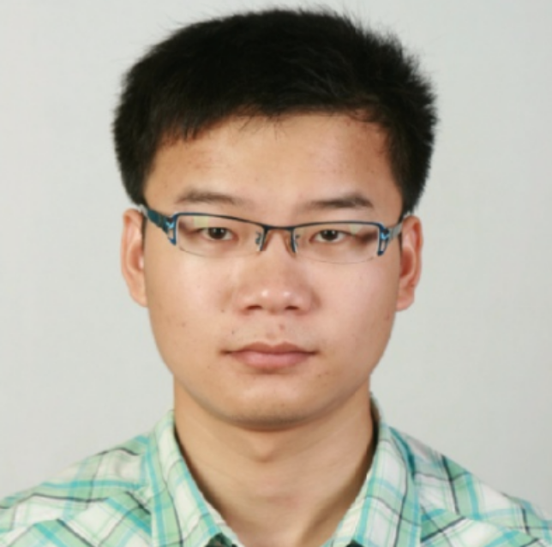
ODAC
One-shot Distributed Algorithm for Cox Proportional Hazards Model

Slide 27

OHDSI use case
Risk factors for acute myocardial infarction (AMI):
gender
age
obesity
alcohol dependence
hypertensive
major depressive disorder
type 2 diabetes mellitus
hyperlipidemia

Slide 28
Recap
ODAL
binary outcome
ODAC
time-to-event outcome
Next:
count outcome
1
2
3

Slide 29


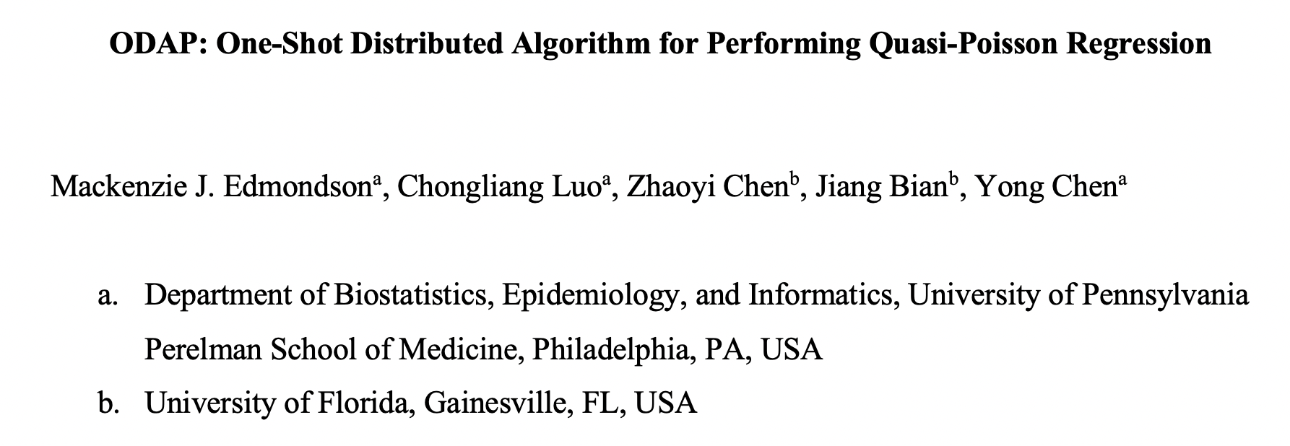
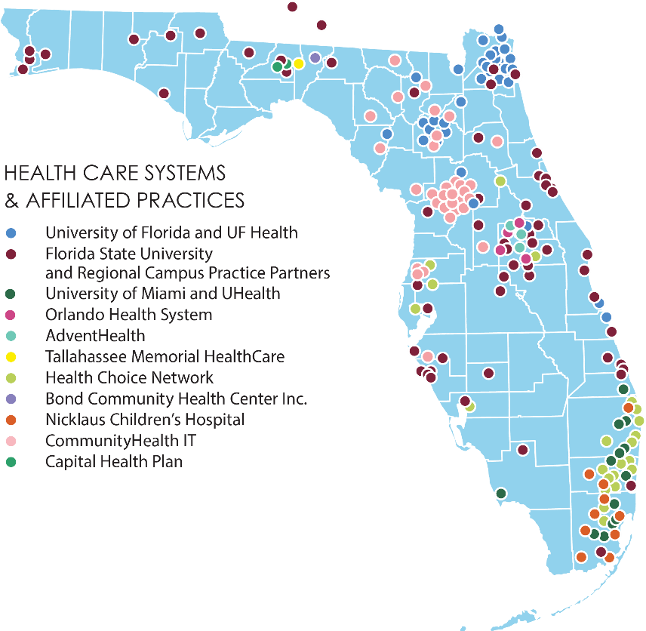
ODAP
One-shot Distributed Algorithm for Quasi-Poisson regression
OneFlorida
15 million Floridians

Slide 30
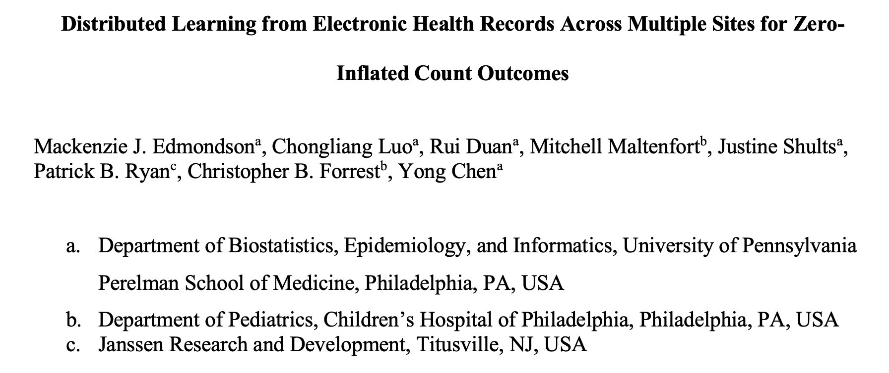
ODAH
One-shot Distributed Algorithm for Hurdle Regression

Slide 31
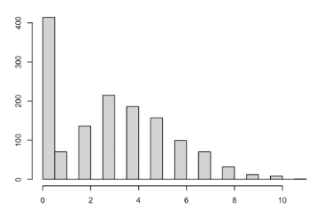
ODAH: Distributed Hurdle Regression Algorithm
$$P\left(w_{i}=1\right)=π_{i}$$
$$\log\left(\frac{π_{i}}{1−π_{i}}\right)=X_{i}^{T}β$$
𝑃(𝑤_𝑖=1)=𝜋_𝑖
log⁡〖(𝜋_𝑖/(1−𝜋_𝑖 ))=𝑿_𝑖^𝑇 𝜷〗
$$w_{i}=0$$
𝑤_𝑖=0
$$w_{i}=1$$
𝑤_𝑖=1
$$y_{i}=0$$
𝑦_𝑖=0
$$P\left(Y_{i}=y_{i} | Y_{i}>0\right)=\frac{e^{−λ_{i}}λ_{i}^{y_{i}}}{\left(1−e^{−λ_{i}}\right)y_{i}!}$$
$$\log\left(λ_{i}\right)=Z_{i}^{T}γ$$
𝑃(𝑌_𝑖=𝑦_𝑖│𝑌_𝑖>0)=(𝑒^(−𝜆_𝑖 ) 𝜆_𝑖^(𝑦_𝑖 ))/((1−𝑒^(−𝜆_𝑖 ) ) 𝑦_𝑖 !)
log⁡〖(𝜆_𝑖 )=𝒁_𝑖^𝑇 𝜸〗
Hurdle model: two-part model
  “Zero” part: logistic regression
  “Non-zero” part: zero-truncated count model (Poisson/Negative Binomial)
Interpretation differs from zero-inflated model
  One source of zeros (sample) vs two (structural)

Slide 32
Recap
ODAL
binary outcome
ODAC
time-to-event outcome
ODAP & ODAH
count outcome
Next:
Heterogeneity
1
2
3
4

Slide 33
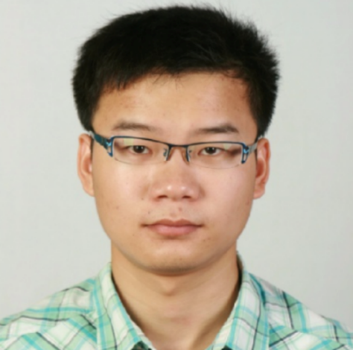
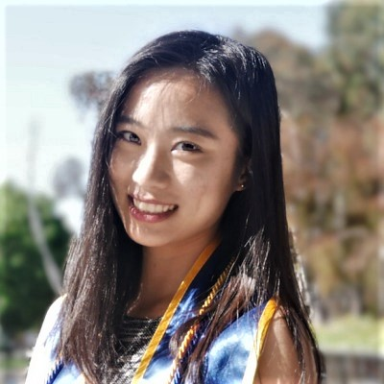

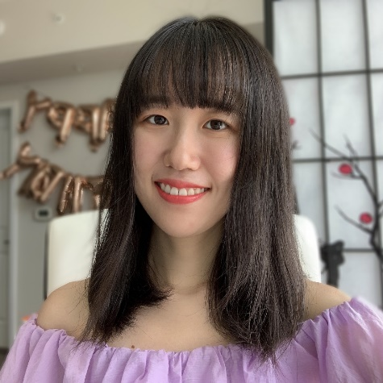
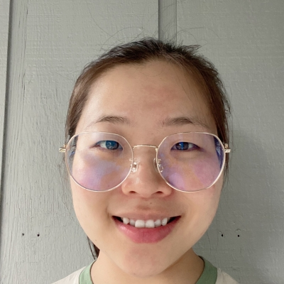

Heterogeneity in distributed research network
Most of existing distributed algorithms ignored the intrinsic nature of between-site heterogeneity
In real-world data, such heterogeneity cannot be ignored

Slide 34
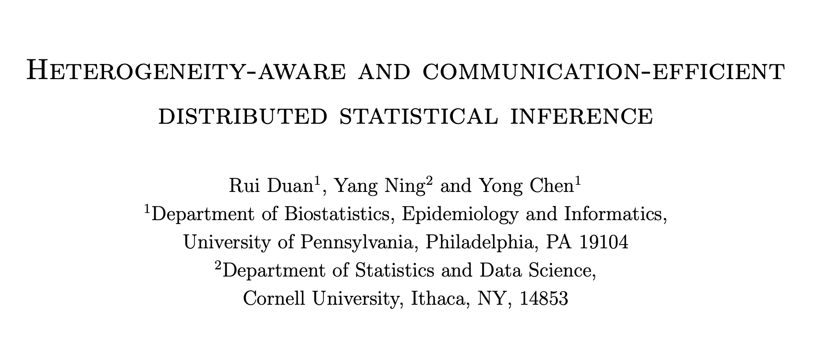
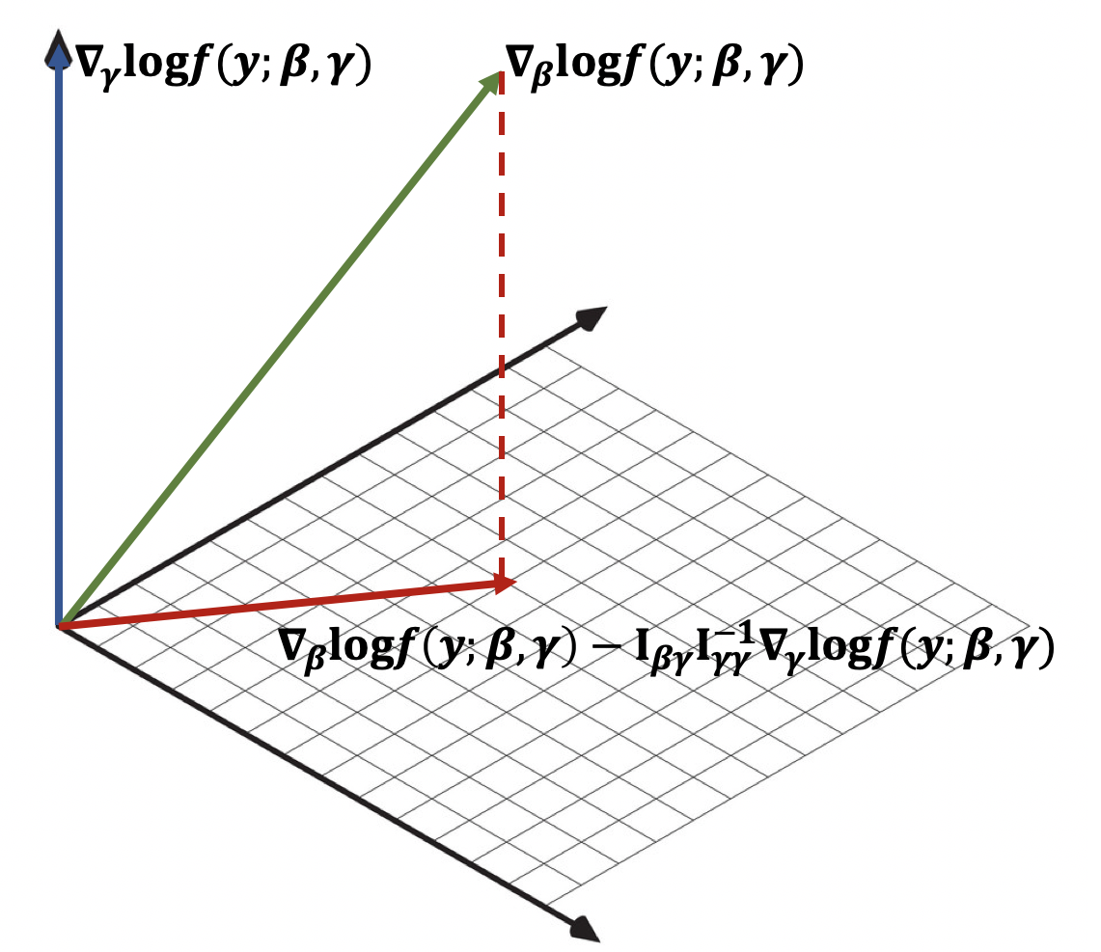
Heterogeneity-aware PDA algorithms
arXiv:1912.09623 Biometrika (invited revision)

Slide 35
“Robustify” PDA algorithms

Slide 36
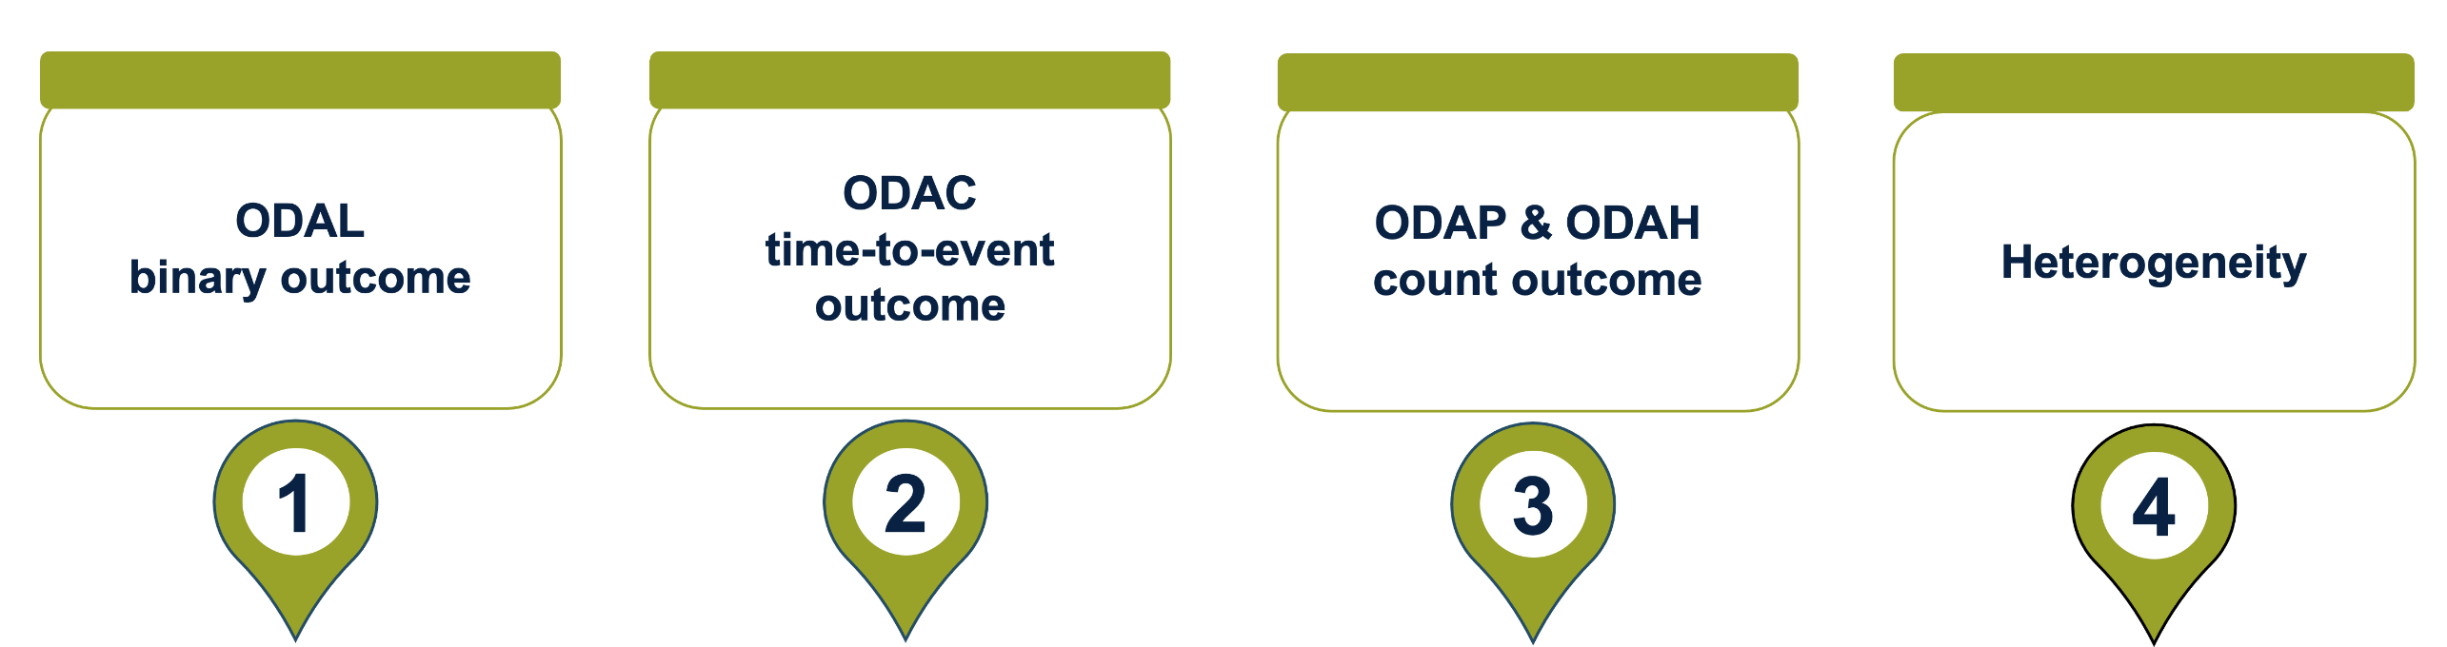
Recap
EHR data
Next:
Biobank Data
5

Slide 37
From EHR to biobank: Secure data integration of multiple biobanks - the “Sum-Share Algorithm”
Li, Chen, Ritchie and Moore, (2020) Nature Review Genetics

Slide 38

Secure data integration of multiple
biobanks - the Sum-Share Algorithm
Li et al., 2020. Nature Communications (in press)

Slide 39

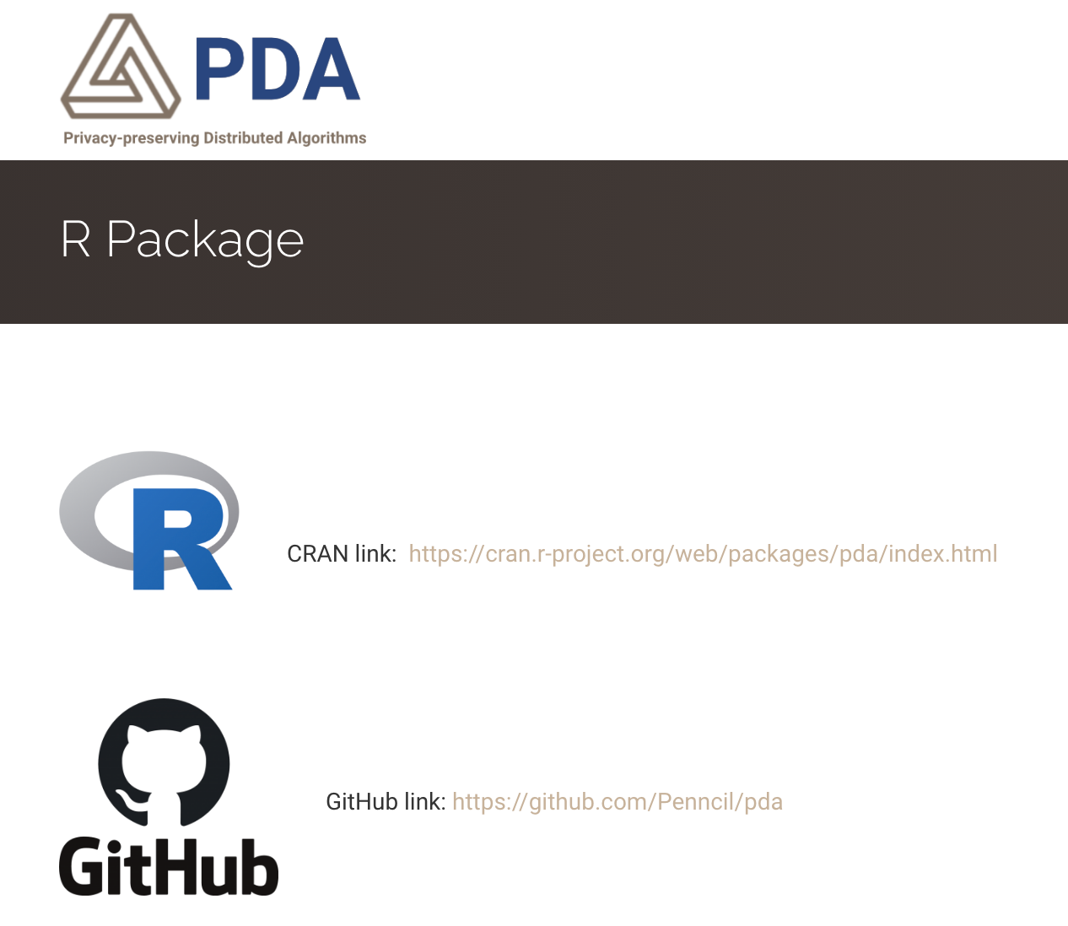
Dissemination and software platform

Slide 40


Building an ecosystem for multi-site studies
Alzheimer‘s Disease (AD)
Opioid Use Disorder (OUD)

Slide 41
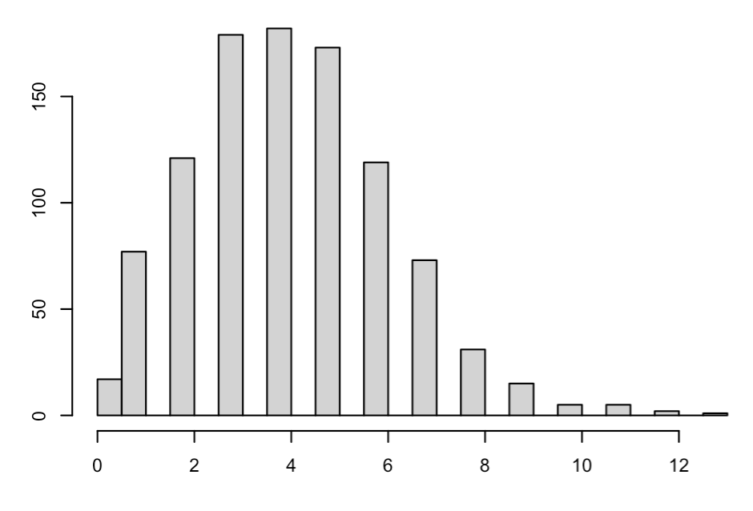
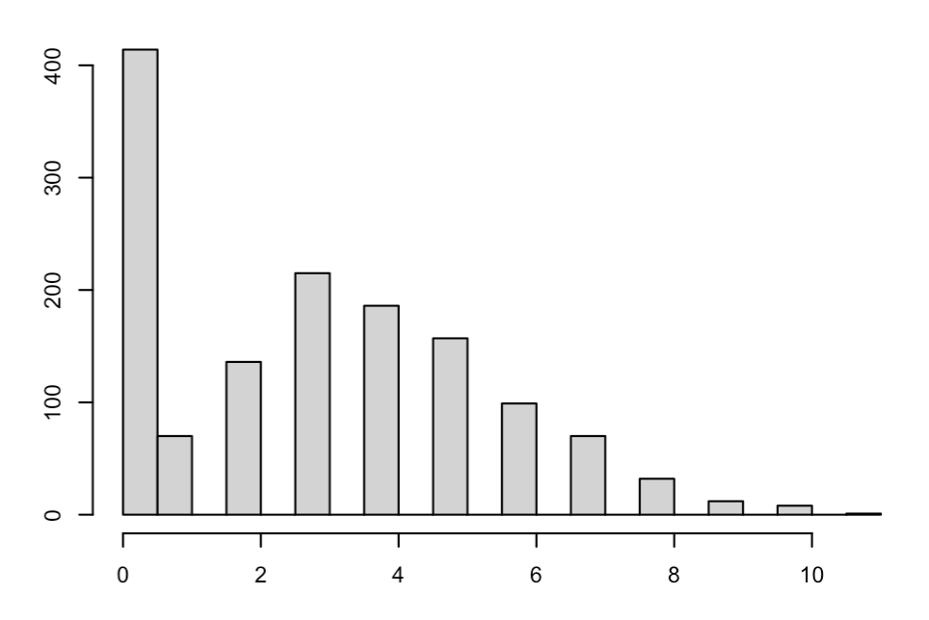
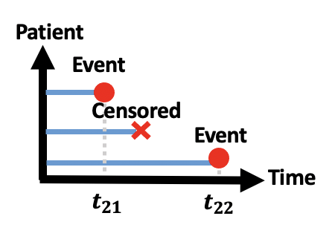
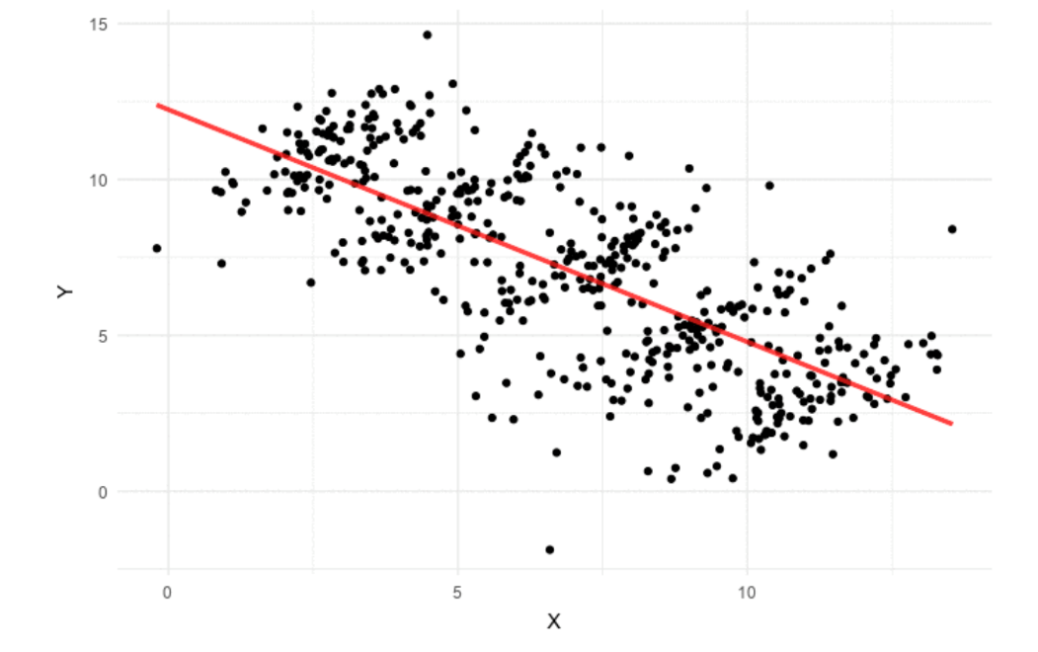

One-shot Distributed Algorithms for Poisson regression
One-shot Distributed Algorithms for Hurdle regression
ODAP
ODAP
ODAH
ODAH
One-shot Distributed Algorithms for Cox regression
ODAC
ODAC
ODAC
PDA
DLMM
PDA
PDA
PDA
Distributed Linear Mixed Model
Robust One-shot Distributed Algorithms for Logistic regression
Robust-ODAL
Robust-ODAL
Robust-ODAL
Robust-ODAL
ODAL
ODAL
ODAL
ODAL
ODAL
One-shot Distributed Algorithms for Logistic regression
1
$$y$$
0
Notes:
Icon for working-on
IDEA:
1. Small circle gradually or jump to a big circle.
2. Then, we have the full name under or besides the circle.
3. Finally, the capital letters merge to the abbreviation, at the same time the full name faded away

Slide 42
ODAP
ODAH
ODAC
PDA
DLMM
Robust-ODAL
…
ODAL
Notes:
Icon for working-on
IDEA:
1. Small circle gradually or jump to a big circle.
2. Then, we have the full name under or besides the circle.
3. Finally, the capital letters merge to the abbreviation, at the same time the full name faded away

Slide 43





Privacy-preserving
Accurate
Communication-efficient
Heterogeneity-aware
PDA
Notes:
The set of methods developed by our group have high promise of evolving into a next generation data sharing strategy.
IDEA: take turn to have color inside; others are grey. Finally, all have colors

Slide 44
Summary
It is just the beginning…

Slide 45
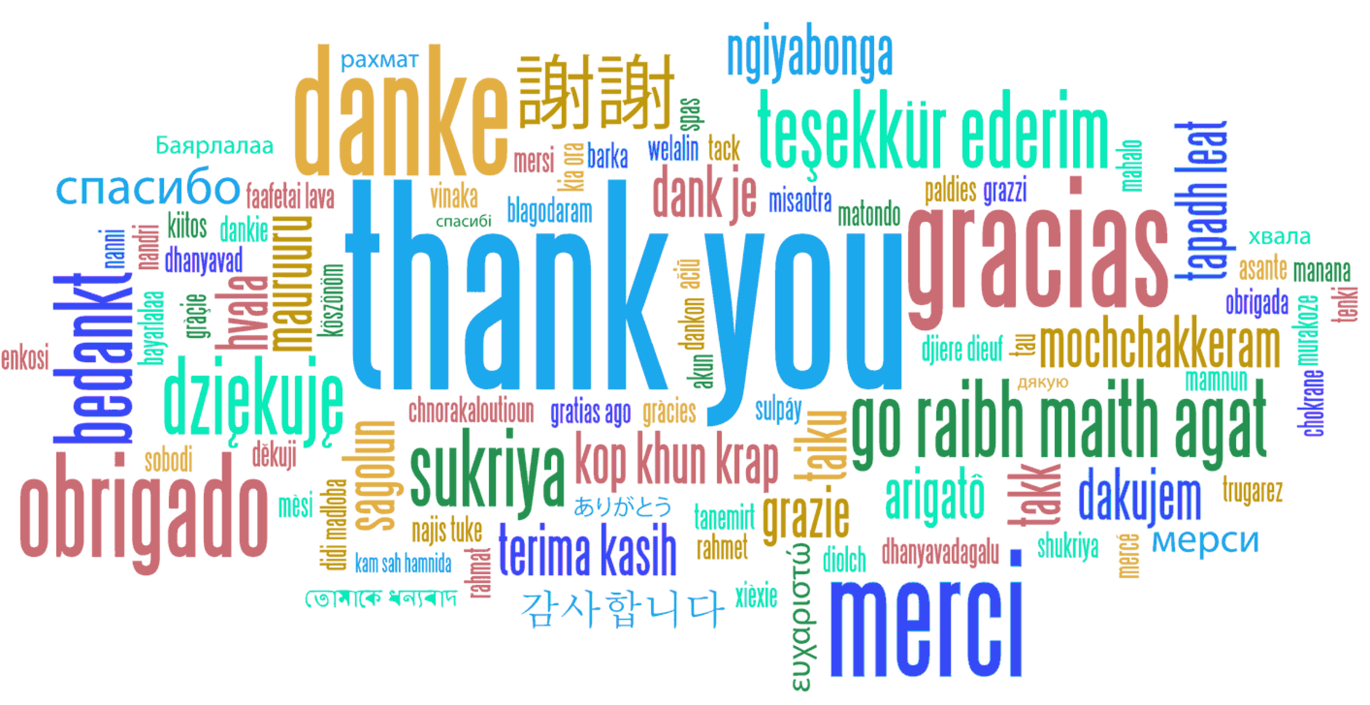
Questions?
https://pdamethods.org/
Twitter: @PennCIL_lab

