Slide 1
Dose Response Characterization: A key to success in drug development
Frank Bretz, Bjoern Bornkamp, Thomas Dumortier
(Novartis)
16th Annual Conference on Statistical Issues in clinical Trials
April 8, 2024
University of Pennsylvania

Slide 2
Outline
Characterizing ‘dose’ throughout drug development
Choosing the doses for a dose finding study
Modelling the dose response relationship
Conclusions

Slide 3
Outline
Characterizing ‘dose’ throughout drug development
Choosing the doses for a dose finding study
Modelling the dose response relationship
Conclusions

Slide 4
‘Dose’ ... what is it?
‘Dose’ is the quantity of medicine we administer, ideally to achieve or maintain a beneficial effect with an acceptable risk or level of undesirable effects
Other aspects may also have to be considered, such as:
Duration of therapy
Frequency of administration and time intervals
Route of administration
Dosage form
The better these factors are understood, the better the chance of delivering the full potential of a drug

Slide 5
‘Dose’ ... a pertinent question throughout drug development
Dose selection is a ‘shared risk’ between sponsors and regulators (EMA 2015) and is relevant in most therapeutic areas (ICH 1994), including oncology (FDA 2023a,b)
First-in-Human: Safely administering a drug to humans at any reasonable dose
Phase 1: Determining the maximum tolerated dose (MTD) beyond which unacceptable side effects are observed (single/multiple ascending or dose escalation studies)
Phase 2a: Assess desirable effects at doses less than or equal to the MTD in a particular indication (proof of concept, PoC)
Phase 2b: Characterization of the dose response relationship for both efficacy and safety
Phase 3: Confirm positive benefit-risk in the target population for one or more selected doses

Slide 6
Importance of finding the ‘right dose’
Insufficiently informed dose selection may lead to:
Delayed approvals
For example, 32% of all drug approved by FDA in 2000-2012 were not approved after first submission but after re-submission only, often due to uncertainty about dose selection (Sacks, 2014).
Post-approval dosage changes, occurring in
20% of the drugs approved in 1980-1999 by FDA; 80% of them for safety reason (Cross, 2002)
11% of the biologicals approved in 2007-2014 by EMA; various reasons (Minnema, 2019)
Potential impact on market entry, benefit-risk of the modified regimen, pricing strategy, ...

Slide 7
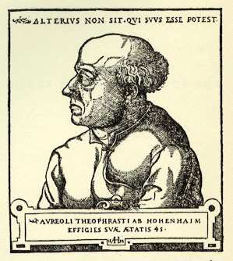
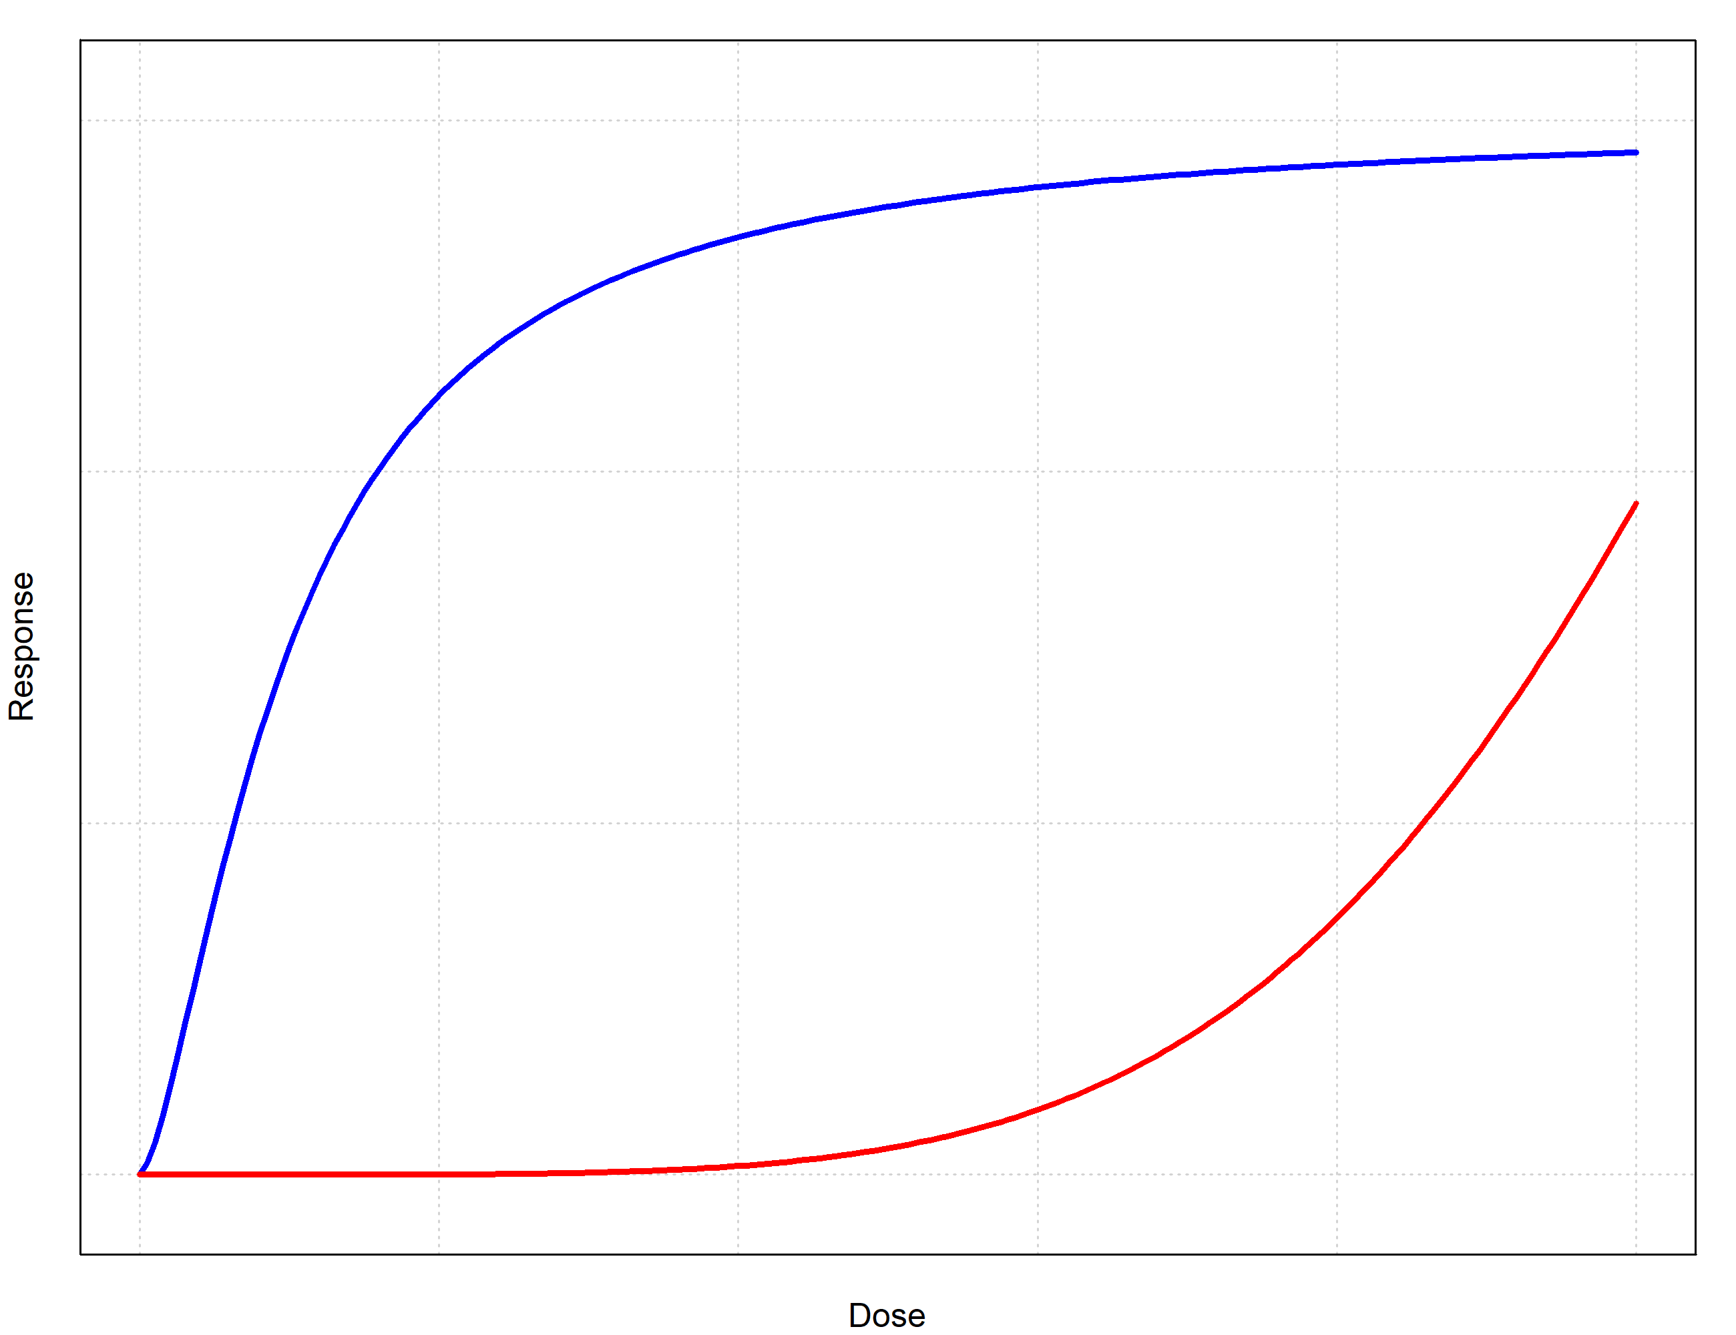
‘Right dose’ ... a trade-off between efficacy and safety/tolerability
Paracelsus (1493 – 1541)
All things are poison and nothing is without poison, only the dose permits something not to be poison.
Dose selection needs to consider efficacy and tolerability/safety
Therapeutic window: Range of efficacious and safe doses
Optimal dose: Trade-off between efficacy and safety
Efficacy
Response
Tolerability/safety
Dose
Therapeutic window

Slide 8
Outline
Characterizing ‘dose’ throughout drug development
Choosing the doses for a dose finding study
Modelling the dose response relationship
Conclusions

Slide 9
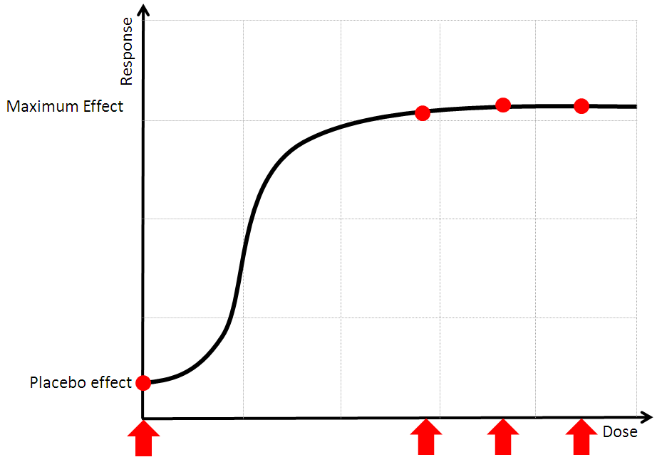
Inappropriate choice of doses (1)
All doses too high
All responses are on the ‘plateau’ of the curve
Unclear how far one can decrease the dose while maintaining efficacy
$1/2$, $1/4$, or $1/{10}$ of the lowest dose?
Particularly problematic when the lowest dose has safety concerns

Slide 10
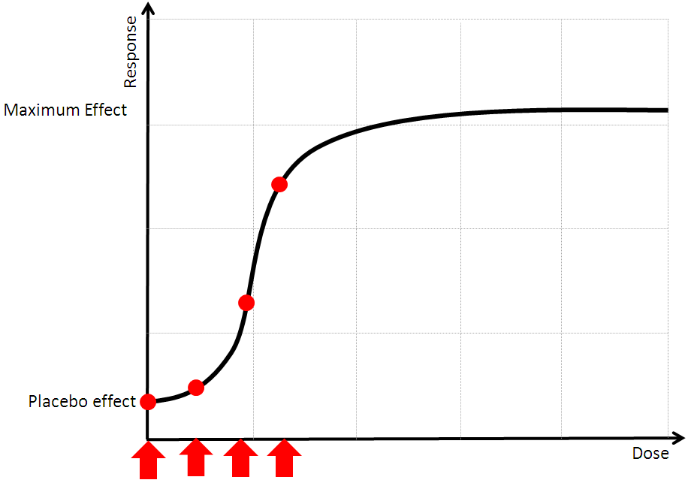
Inappropriate choice of doses (2)
All doses too low
All response below the ‘plateau’ of the curve
Only a partial identification of the increasing part of the curve
Unclear how far one can increase the dose to obtain better efficacy
2-, 4- or 10-fold of the highest dose?
Particularly problematic when the highest dose has no safety concerns

Slide 11
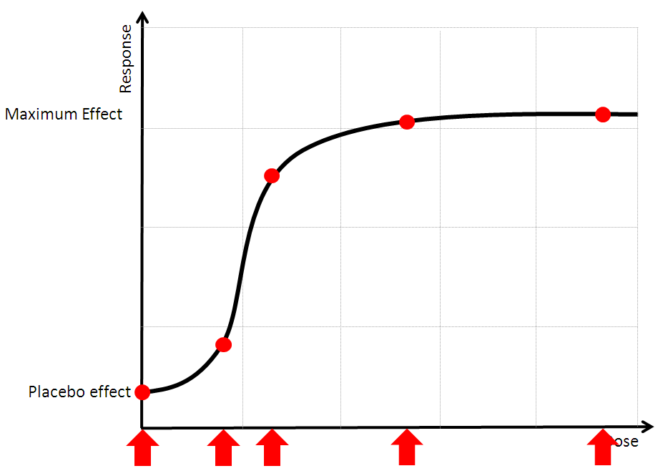
Appropriate choice of doses
Ideal allocation covers both the steep part of the curve and the plateau
To mitigate risk of improper dose selection:
Use more dose levels, say 4-5 (perhaps, fewer patients per dose)
Use adequate dose range and dose spacing (see next slide)
Potentially more efficient: adaptive dose finding studies (see further below)

Slide 12
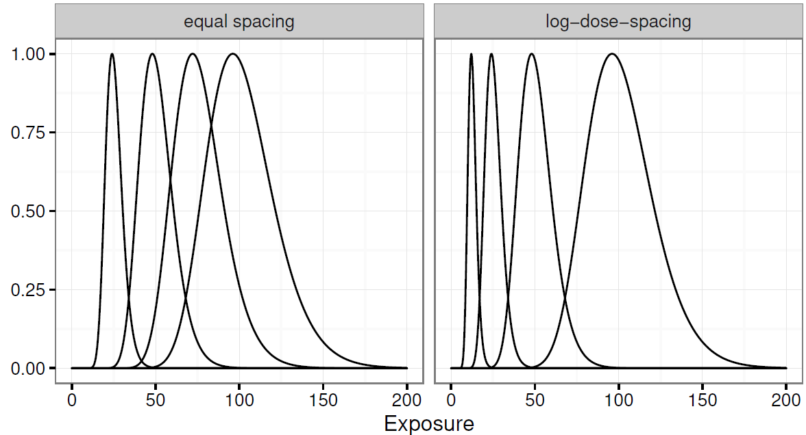
Recommendations for dose range and spacing
Highest dose usually determined based on tolerability/safety considerations in Phase I or PoC studies
Lowest dose usually based on pharmacological considerations, such as
Fast pharmacokinetics (PK) elimination may indicate loss of target occupancy
Dose response for marker of activity coming from healthy volunteers' study (when they exist)
Rule of thumb: Use at least a 10-fold dose-range (EMA, 2015)
Dose spacing: Often an approximately equal spacing on a log-dose scale is used (e.g., 1, 3, 10, 30 mg)
Rationale: drug concentration (exposure) is generally dose-proportional and log-normally distributed (i.e., higher doses cover a wider exposure range due to the increased variability)
For other dose spacing rules see, e.g., Yuan and Ting (2014)

Slide 13
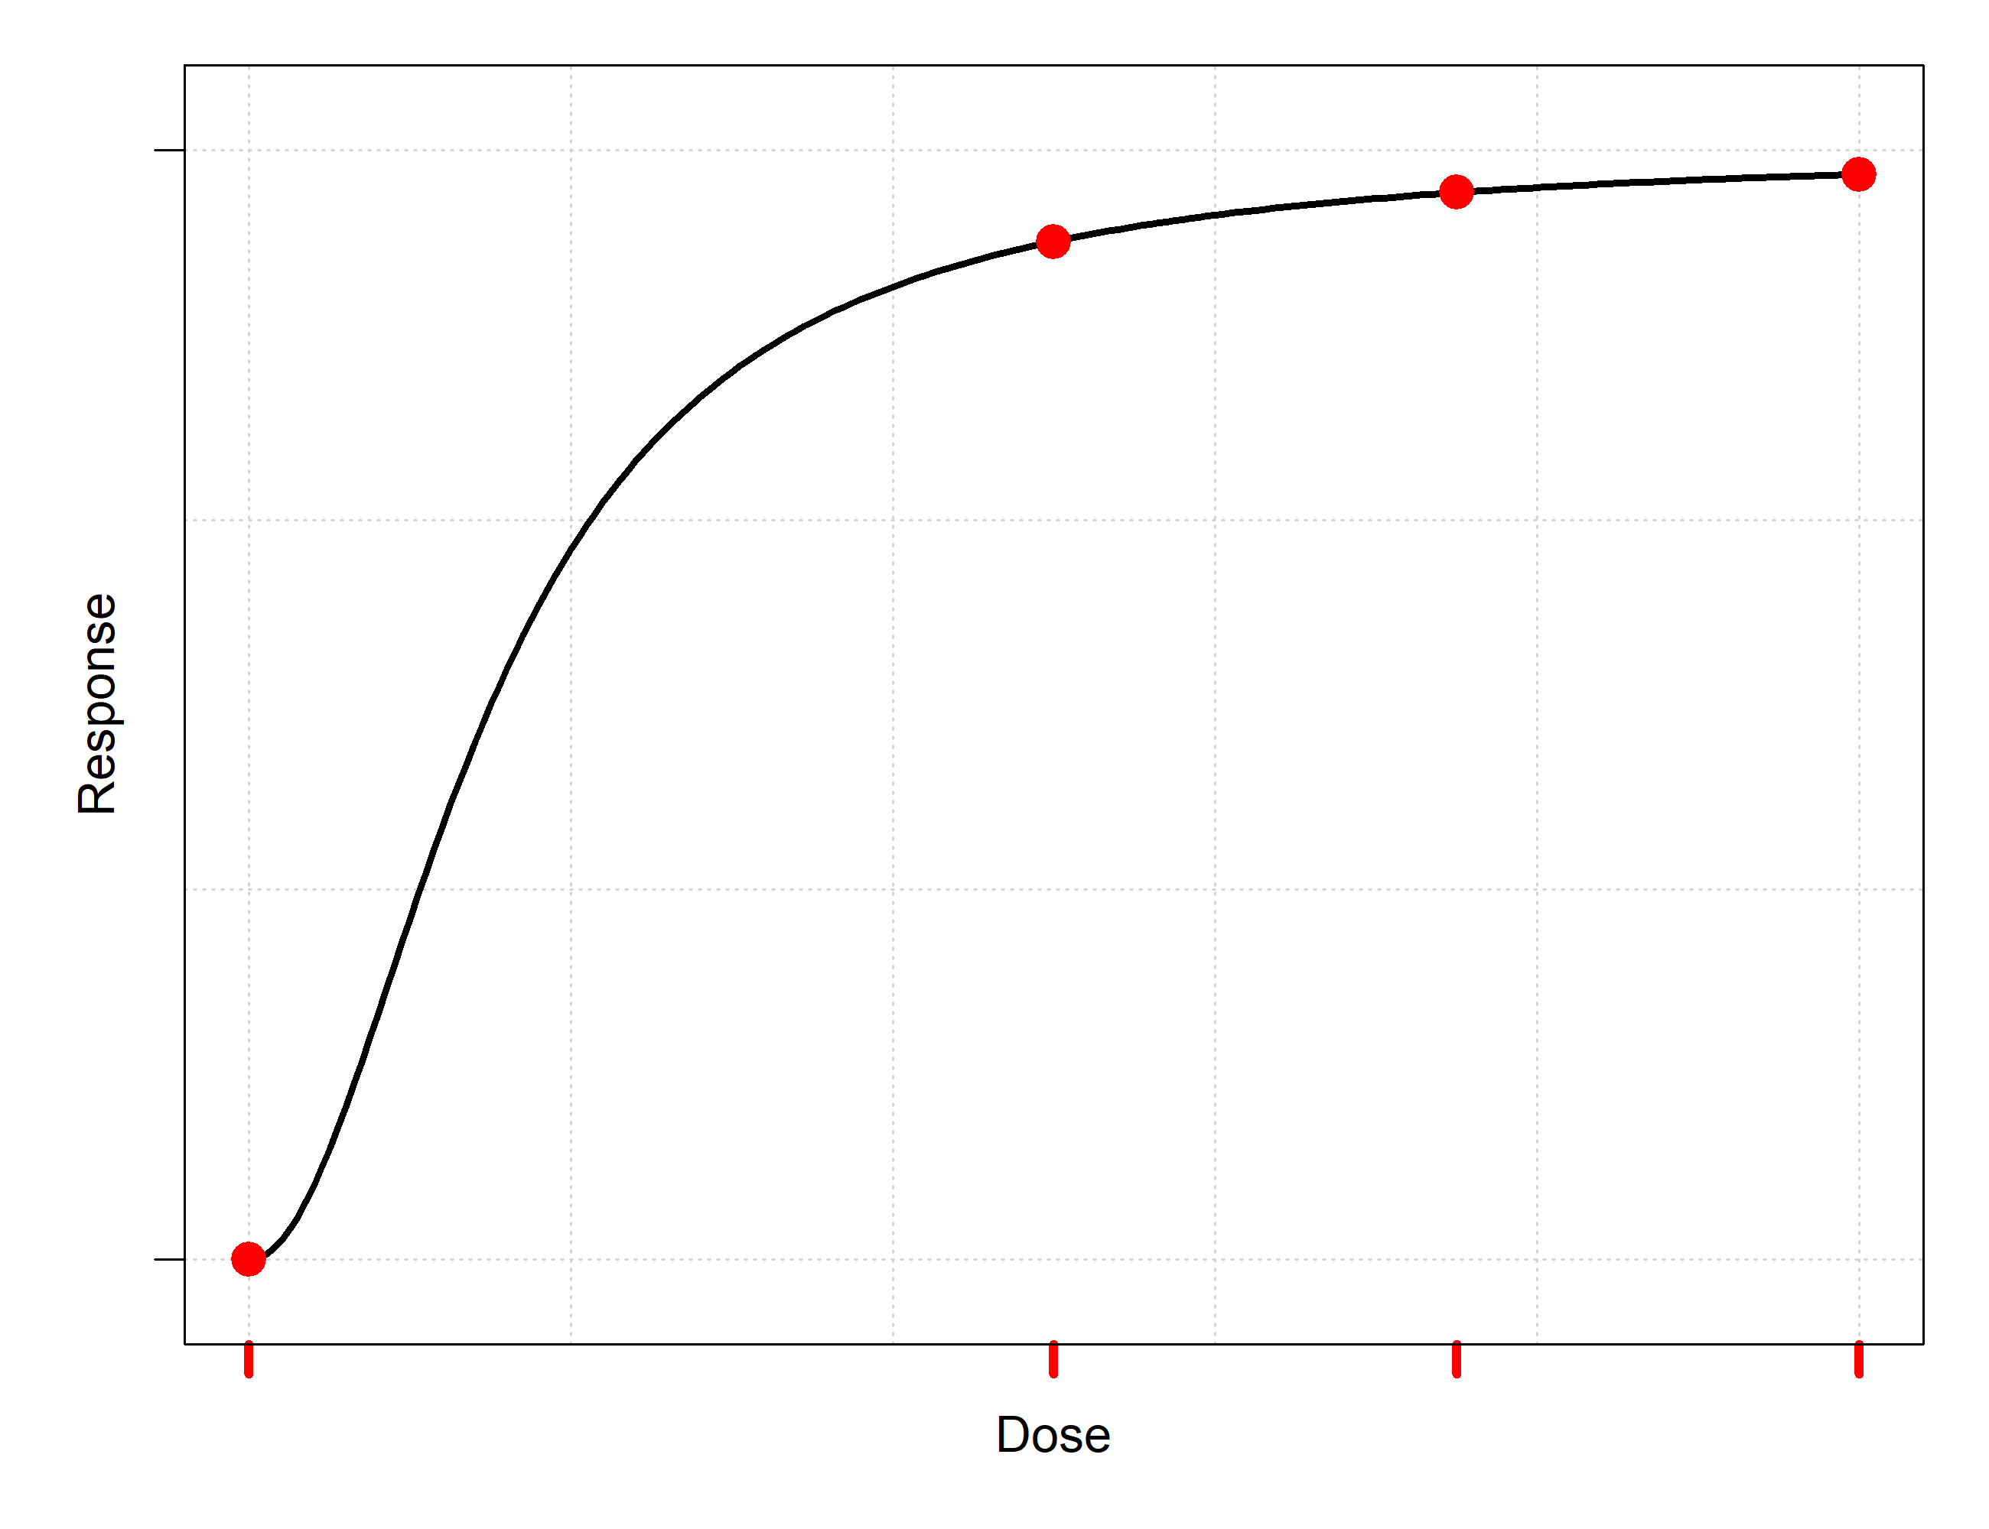
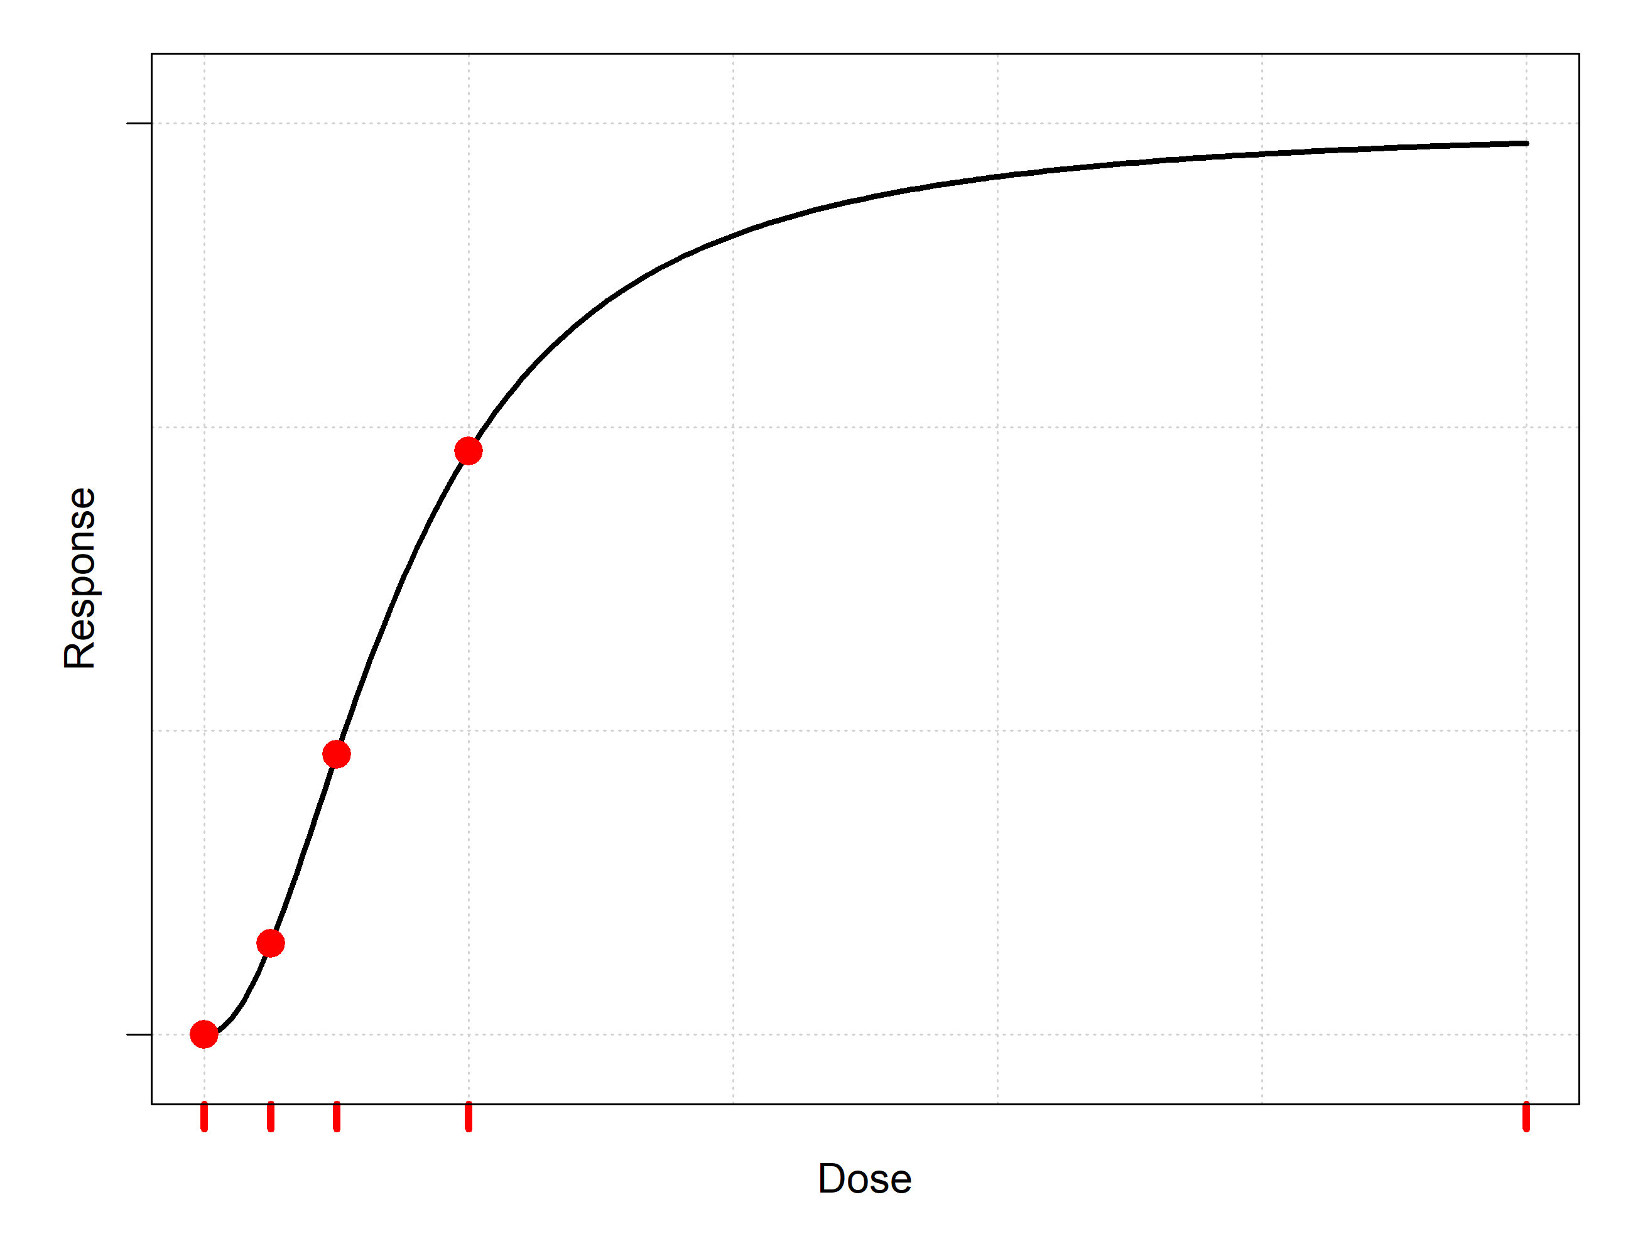
Why adaptive dose finding?
Address uncertainty about design aspects in a dose finding trial
Dose range and dose levels
Adaptive allocation of new patients by changing the randomization weights for doses in the trial
Start with largest possible dose-range and then “zoom in“ to cover doses on plateau and increasing part
Effect size
Allow for early stopping (usually futility)
Sample size adaptation
Add doses here
Add doses here

Slide 14
Outline
Characterizing ‘dose’ throughout drug development
Choosing the doses for a dose finding study
Modelling the dose response relationship
Conclusions

Slide 15
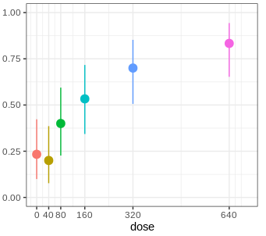
How to characterize dose response?
Dose finding trials in Phase 2b are generally of moderate sample size
This sample size, further divided by dose group, results in limited precision of within-dose mean response estimates
Simulated trial with 30 patients per dose group

Slide 16
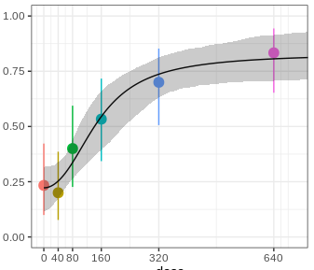
How to characterize dose response? (cont’d)
Often reasonable to assume monotonic dose response relationships which plateaus at high dose
For example, the sigmoid emax model has a pharmacological (Holford, 2017) and an empirical justification (Thomas, 2014)
Using models which implement such assumptions increases the information provided by the data
Every point of the fitted curved is influenced by the entire data
More precise estimates of mean response specific to a dose
dose
Simulated trial with 30 patients per dose group

Slide 17
Dose exposure response relationship
Principle: Factor the ‘dose response’ relationship into ‘dose exposure’ and ‘exposure response’ relationships
Legitimacy:
Often reasonable to believe exposure mediates the entire effect of the dose on the response
Explain part of the variability in dose response
Challenges:
Risk of confounding of the exposure response relationship, see the example of pembrolizumab (Turner, 2018)
Requires model selection process which is difficult to pre-specify
Dose and regimen
Exposure (i.e., drug concentration or PK metric)
Response

Slide 18
Dose exposure response relationship (cont’d)
Dose exposure response relationships are highly relevant for dose selection (FDA, 2003)
Cornerstone of Model Informed Drug Development (MIDD)
Predict efficacy and safety of untested dosing regimen, e.g., change in loading regimen, new route of administration
Support the selection of pediatric regimens
Integrate data across development phases and dosing regimens
See forthcoming ICH E11A and ICH M15 guidelines

Slide 19
Dealing with model uncertainty Good modeling practice
Generally impossible to be fully confident that the assumed dose response model is the true one
Even if it is the true dose response model, the doses available in the study may not allow to estimate the full relationship
Only simpler models can be fitted
Pre-specification of a single dose response model at the design stage is difficult and potentially risky
Conversely, no rigid pre-specification of how models are selected may potentially lead to overfitting data
Very important to use methods which correctly account for the uncertainty related to the model(s) used for estimation (model averaging, cross-validation, ...)

Slide 20
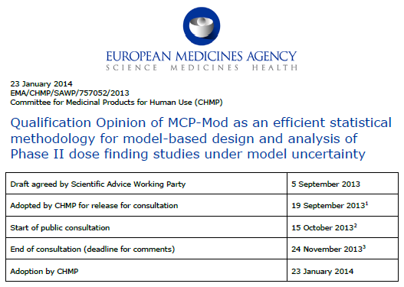
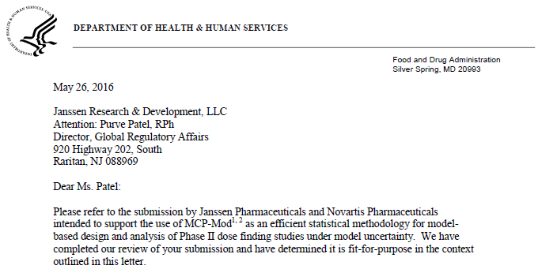
Dealing with model uncertainty A statistical approach: MCP-Mod
MCP-Mod (Multiple Comparison Procedures and Modelling; Bretz et al., 2005) combines
statistical test for a dose response signal (MCP-step)
model selection or averaging for estimation of the dose response curve and target doses of interest (Mod-step)
Structured approach to model uncertainty by pre-specifying
Candidate dose response models
Criteria for dose response signal detection
Criteria for model selection/averaging
Qualification opinion by EMA (2014) and Fit-for-Purpose Determination by FDA (2016)

Slide 21
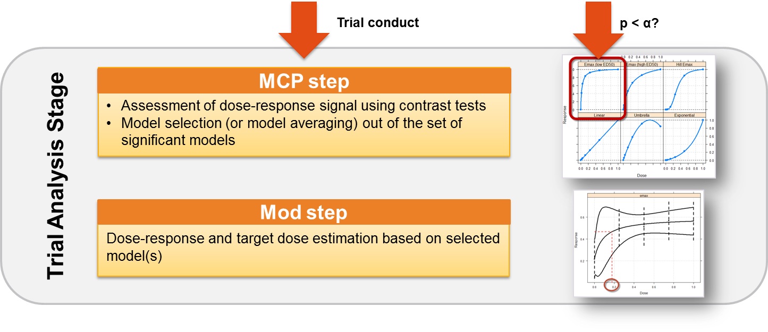
MCP-Mod: A primer

Slide 22
Outline
Characterizing ‘dose’ throughout drug development
Choosing the doses for a dose finding study
Modelling the dose response relationship
Conclusions

Slide 23
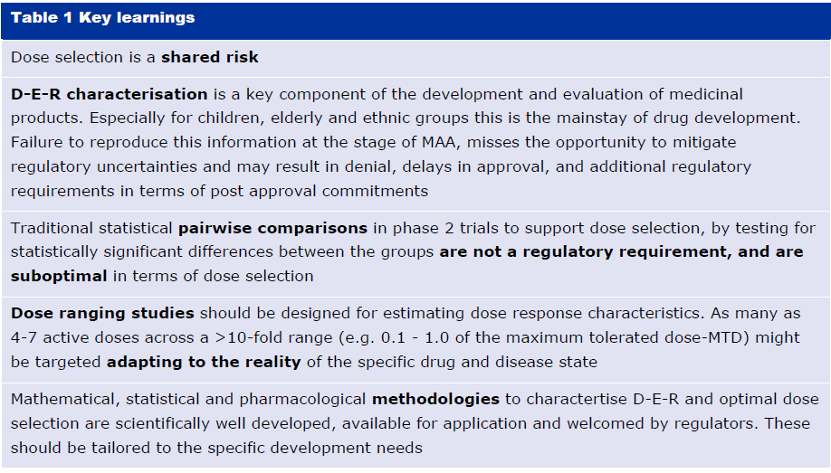
Report from the ‘Dose Finding Workshop’ at EMA in 2014 (EMA 2015, Musuamba et al. 2017)

Slide 24
Thank you

Slide 25
References
Bretz, Pinheiro, Branson (2005) Combining multiple comparisons and modeling techniques in dose-response studies. Biometrics 61:738-748
Cross (2002) Post-marketing drug dosage changes of 499 FDA-approved new molecular entities, 1980–1999. DOI: 10.1002/pds.744
EMA (2014) Qualification opinion of MCP-Mod as an efficient statistical methodology for model-based design and analysis of Phase II dose-finding studies under model uncertainty. EMA/CHMP/SAWP/757052/2013. Available at www.ema.europa.eu
EMA (2015) Report from the Dose Finding Workshop at EMA. EMA/117491/2015. Available at www.ema.europa.eu
FDA (2003) Guidance for Industry: Exposure-Response Relationships - Study Design, Data Analysis, and Regulatory Applications. Available at www.fda.gov
FDA (2016) Fit-for-Purpose Determination of MCP-Mod. Available at www.fda.gov
FDA (2023a) Project Optimus. Available at www.fda.gov
FDA (2023b) Draft Guidance for Industry: Optimizing the Dosage of Human Prescription Drugs and Biological Products for the Treatment of Oncologic Diseases. Available at www.fda.gov
Holford (2017) Pharmacodynamic principles and the time course of immediate drug effect. DOI: 10.12793/tcp.2017.25.4.157
ICH (1994) Topic E4: Dose response information to support drug registration. Avaialable at www.ich.org
Minnema, 2019. Post-marketing dosing changes in the label of biologicals. DOI: 10.1111/bcp.13843
Musuamba FT, Manolis E, Holford N, Cheung SYA, Friberg LE, et al. (2017) Advanced methods for dose and regimen finding during drug development. CPT Pharmacometrics Syst. Pharmacol. 6, 418–429.
Sacks, 2014. Scientific and Regulatory Reasons for Delay and Denial of FDA Approval of Initial Applications for New Drugs, 2000-2012. DOI: 10.1001/jama.2013.282542
Thomas, 2014. Meta-Analysis of Clinical Dose–Response in a Large Drug Development Portfolio. DOI: 10.1080/19466315.2014.924876
Turner, 2018. Pembrolizumab Exposure–Response Assessments Challenged by Association of Cancer Cachexia and Catabolic Clearance. DOI: 10.1158/1078-0432.CCR-18-0415
Yuan, Ting (2014). First dose ranging clinical trial design—More doses? Or a wider range. In: Clinical Trial Biostatistics and Biopharmaceutical Applications, 91-110. DOI: 10.1201/b17716-11

