Slide 1
Dose Finding in HIV-1 Preventive Vaccine and Monoclonal Antibody Studies
Yunda Huang, Ph.D.
Associate Professor, Vaccine and Infectious Disease Division,
Fred Hutchinson Cancer Center
Affiliate Associate Professor, Department of Global Heath, University of Washington

Slide 2
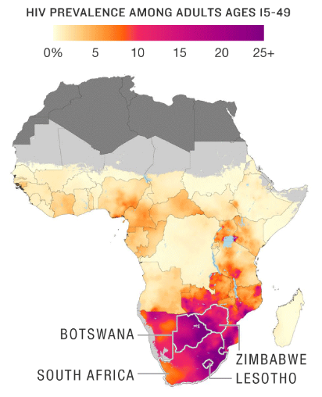
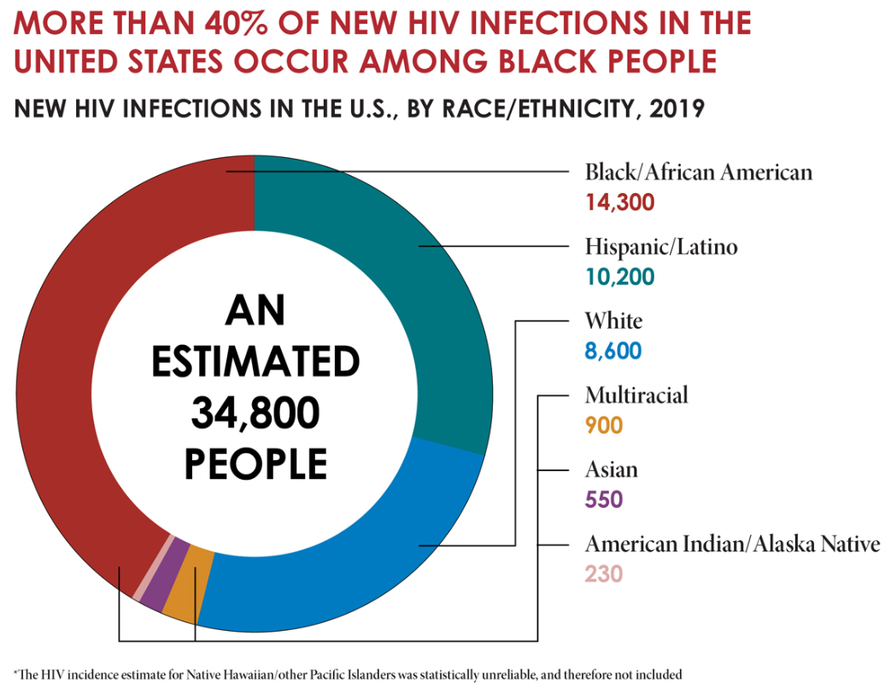


HIV is Global and Domestic
Dwyer-Lindgren et al., Nature (2019)

Slide 3

In 2022, globally
39 million people were living with HIV.
1.3 million people acquired HIV.
Every week, 4000 girls and women (15–24 yrs old) acquired HIV. 80% of these new infections were in sub-Saharan Africa.
HIV infection is irreversible; our body does not clear the virus naturally.
  Current anti-retroviral therapy (ART) alone does not cure HIV infection and requires lifelong drug treatment.

Slide 4
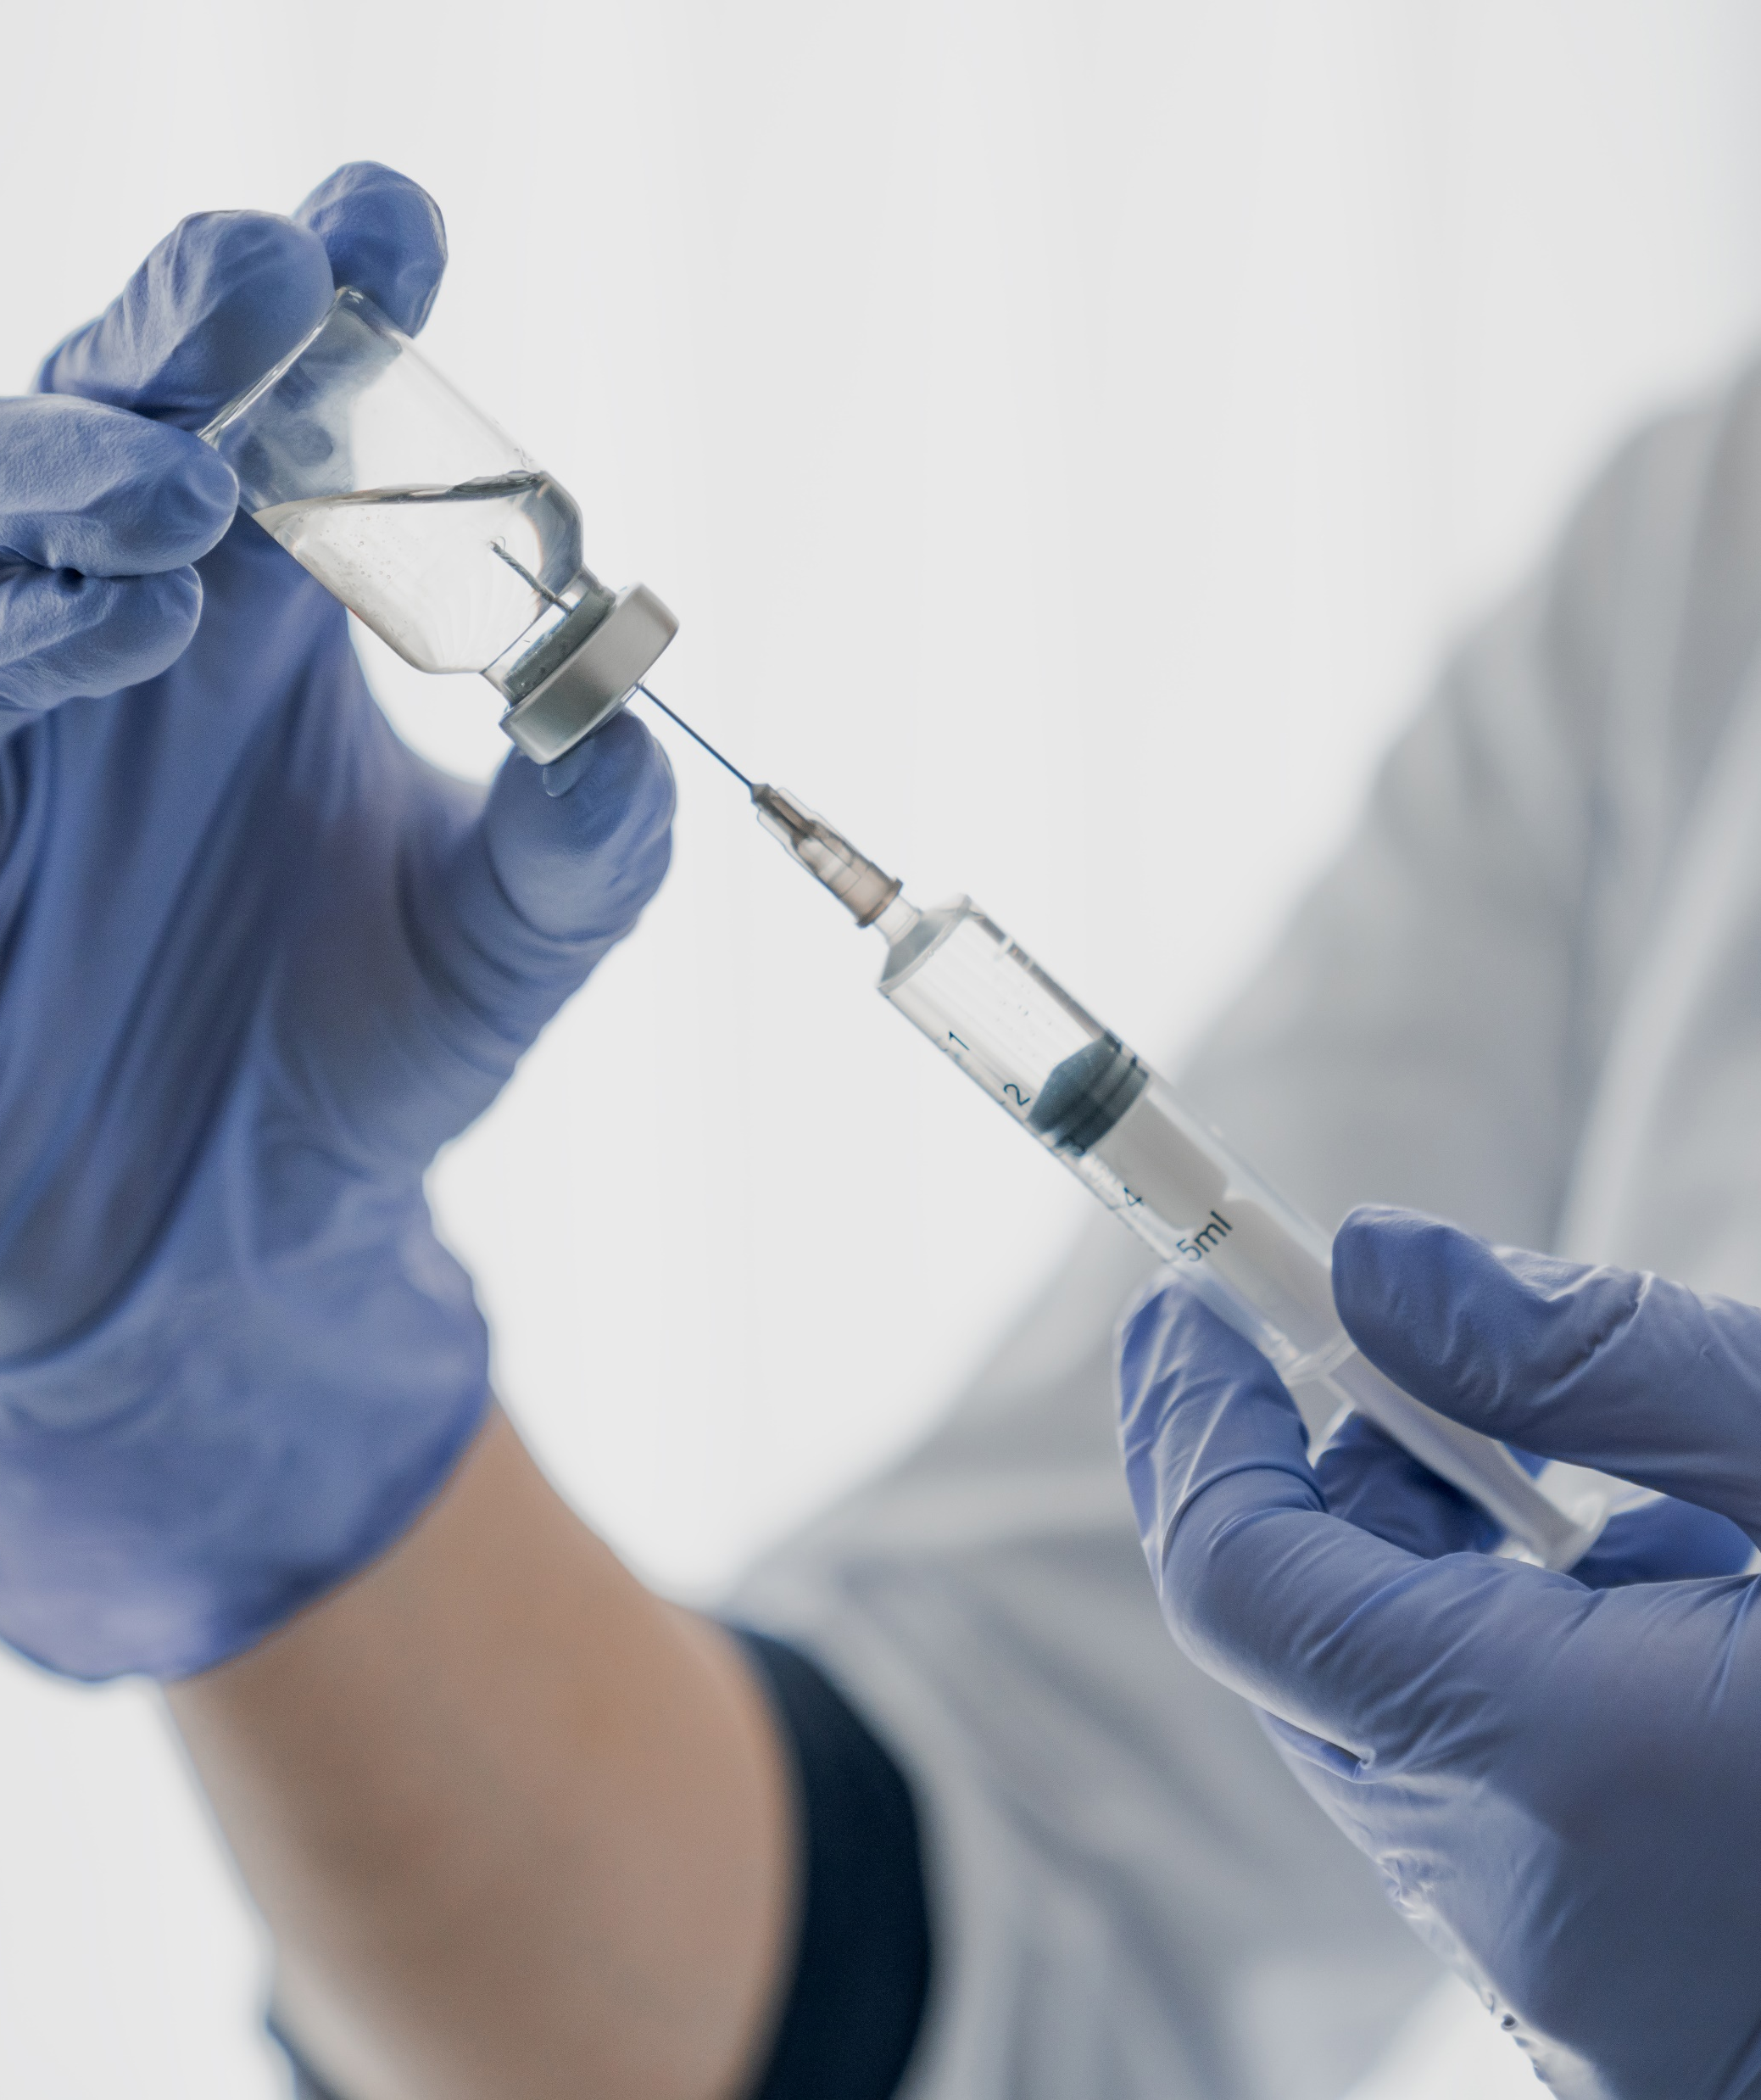
The current HIV epidemic calls for a powerful array of HIV prevention tools that are widely accessible to all.
Vaccines historically have been the most economic and effective means to prevent and even eradicate infectious diseases.
A preventive vaccine is our best hope for ending the HIV-1 epidemic.

Slide 5
HIV Vaccine Research
Where have we been?
Where are we going?

Slide 6
1 year
1 year
HIV Preventive Vaccine Efficacy Was Modest &
Not Durable At Best in Past Clinical Trials
1995
2000
2005
2010
2015
2020
1
2
3
4
5
6
7
8
9
VaxGen USA (gp120)
VaxGen Thai Trial (gp120)
Step & Phambili Trials (Ad5 gag/pol/nef)
RV144 Thai Trial (ALVAC/gp120)
HVTN 505 (DNA/Ad5 env/gag/pol)
HVTN 702 (Clade C ALVAC/gp120)
HVTN 705 (Ad26 mosaic/gp140)
HVTN 706 (Ad26 mosaic/mosaic gp140)
PrEPVacc (DNA, MVA Env)
Trial start/end
Trial analysis/results
Slide Adapted from Ann Duerr

Slide 7

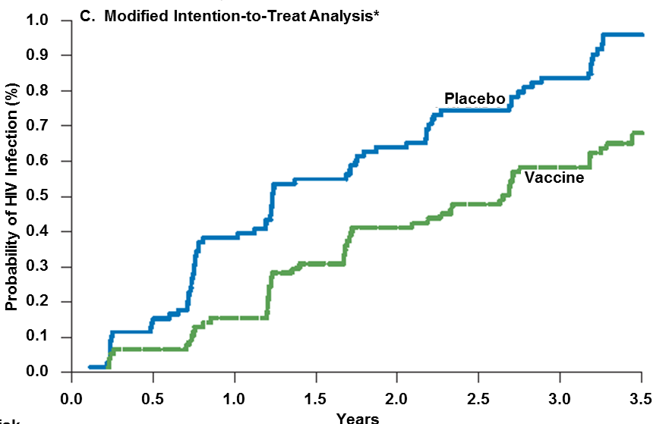
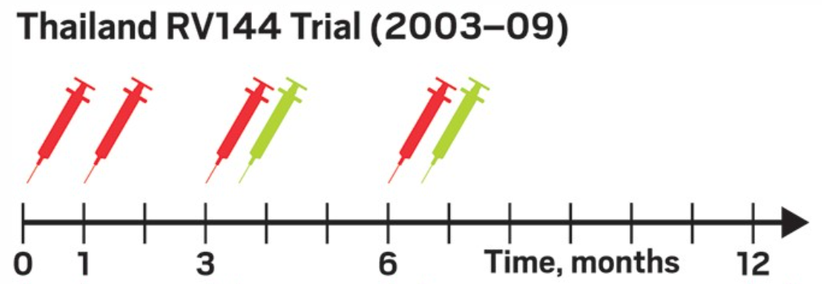
RV144 Results: Vaccine Efficacy = 31% for Prevention of HIV Acquisition
N Eng J Med. 2009; 361:2209
VACCINE EFFICACY: 31% (95% CI: 1-51%)

Slide 8
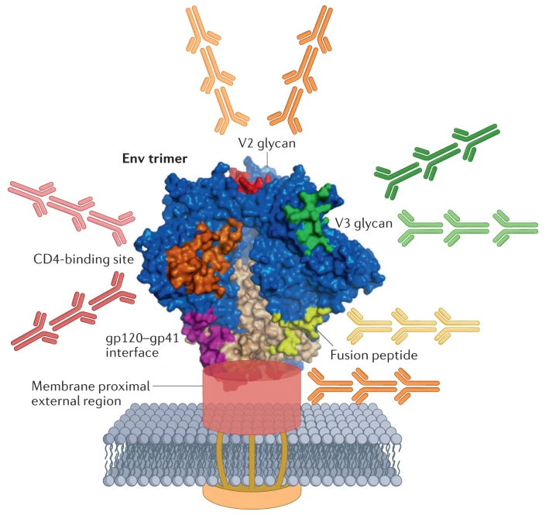
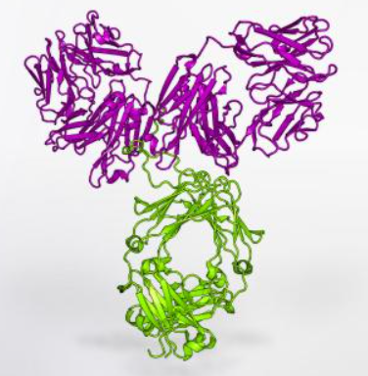
Some people living with HIV-1 develop broadly neutralizing antibodies (bnAbs) that are able to neutralize a wide variety of HIV strains.
The HIV-1 prevention field has been exploring two new approaches
1. Passive immunization of broadly neutralizing monoclonal antibodies
2. Active immunization of bnAb-inducing vaccines
A protein structure diagram of a broadly neutralizing monoclonal antibody (VRC/NIAID/NIH)
A prototype HIV-1 vaccine for the induction of bnAbs (Haynes et al., 2022 Nat Rev Immunol)

Slide 9
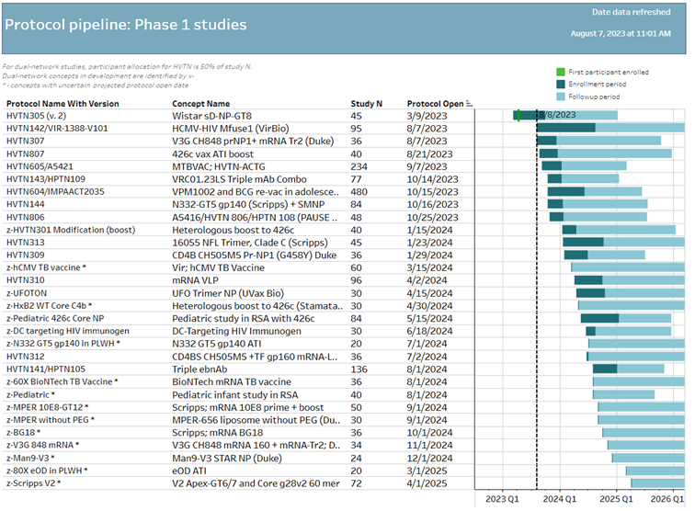

Slide 10
Dose Finding in HIV-1 Preventive Vaccine Clinical Trials
3+3 design or adaptive designs based on immunogenicity data (e.g., collected at 2-4 weeks after the final dose of the vaccine regimen) are typically not feasible due to the long wait
The maximum tolerable dose (MTD), i.e., the highest dose of a vaccine that does not cause unacceptable side effects is typically chosen as the final dose, unless suggested by immunogenicity data otherwise.
  No clear immunological surrogate endpoint of HIV vaccine efficacy has been identified yet

Slide 11
Dose Finding in Monoclonal Antibody Studies

Slide 12

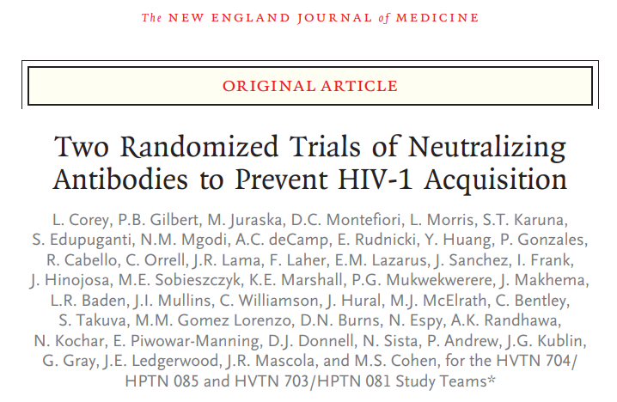



gp41 trimer
gp120
trimer
CD4
VRC01 Blocks Attachment to CD4
CCR5
Target Cell

Slide 13



The AMP Trials: Schema
 | HVTN704/HPTN085 | HVTN703/HPTN081
REGIMEN | MSM & TG persons in the Americas & Europe | Women in sub-Saharan Africa | TOTAL
VRC01 10 mg/kg | 900 | 633 | 1533 | 10 infusions total & Infusions every 8 weeks Study duration: ~22 months
VRC01 30 mg/kg | 900 | 633 | 1533
Control | 900 | 634 | 1534
Total | 2700 | 1900 | 4600
Week 80 is the last study visit for the primary endpoint analysis of prevention efficacy; Week 104 is the last study visit for assessing safety and tolerability, the tail of VRC01 concentration decline, and a final HIV-1 test
HIV-1 tests administered every 4 weeks through Week 80, then at Week 88, 96, 104

Slide 14

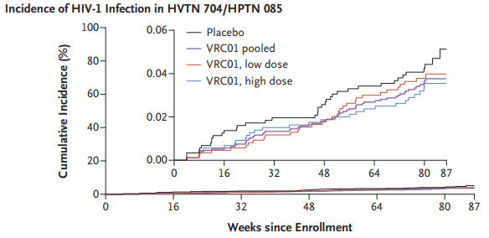
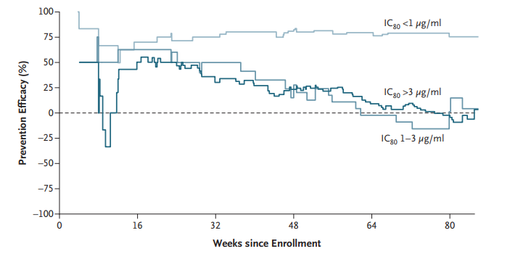
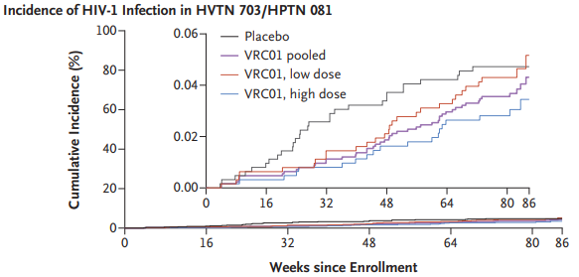
No Overall Efficacy
~75% Efficacy of VRC01 Against VRC01-Sensitive Viruses (IC80 < 1 µg/ml)
Corey, Gilbert et al. (2021, NEJM)
IC80: in vitro inhibitory concentration of VRC01 corresponding to 80% neutralization of an acquired virus

Slide 15
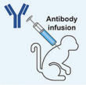

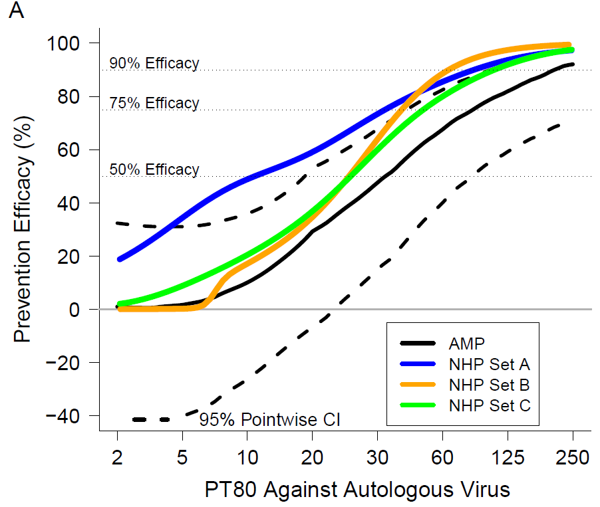
Prevention Efficacy (PE) Smoothly Increases with Predicted ID80 (PT80) Titer in AMP* and in NHP ** studies
  PT80 = 80 → ~75% PE
  PT80 = 200 → ~90% PE
NHP Set A: all 16 mAbs and 7 challenge viruses
NHP Set B: CD4-bs mAbs, excluding SF162P3
NHP Set C: excluding MPER mAbs and SF162P3
*Gilbert, Huang et al., 2022; **Pegu et al., 2019
PT80 Against Acquired Virus

Slide 16
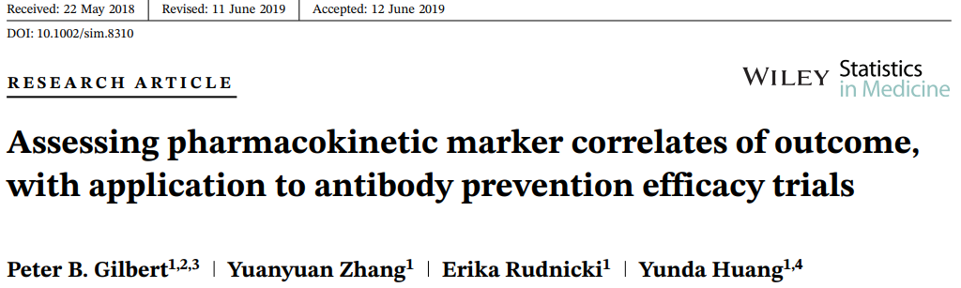
Building Blocks that Contributed to Identification of Concentration and Neuralization Correlates in AMP
VRC01 PK modeling work
Prediction of serum neutralization
Other…
Survival data simulation system
David Montefiori
Duke

Slide 17

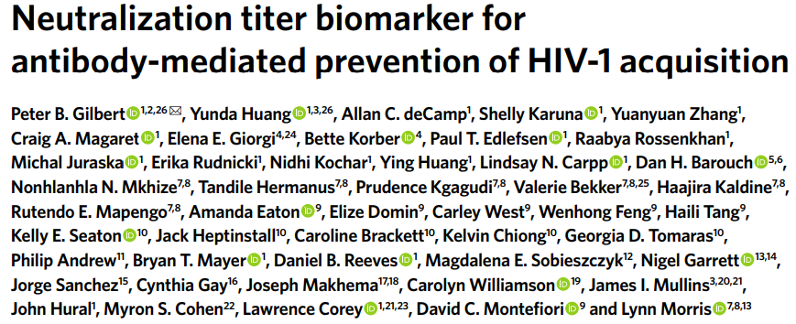




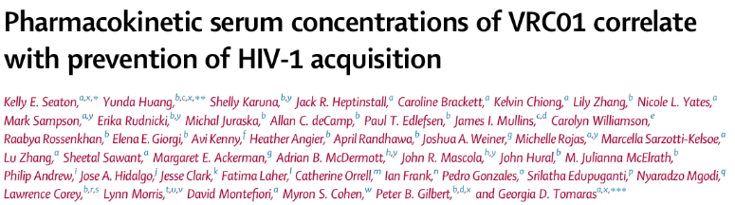

Building Blocks that Contributed to Identification of Concentration and Neuralization Correlates in AMP
PT80
VRC01 PK modeling work
Prediction of serum neutralization
Other…
Survival data simulation system
Lynn Morris
NICD, South Africa
David Montefiori
Duke
Georgia Tomaras
Duke
Peter Gilbert
Fred Hutch
David Montefiori
Duke

Slide 18
Predicting Prevention Efficacy of a Triple-bnAb Combination Against AMP Placebo Viruses
A
PGDM1400LS + PGT121LS + VRC07-523LS 40+40+40 mg/kg
PGDM1400LS + PGT121LS + VRC07-523LS 40+40+40 mg/kg
PGDM1400LS + PGT121LS + VRC07-523LS 20+20+20 mg/kg
HVTN703
/HPTN081
(m=47 viruses)
VRC01 40 mg/kg every 4 weeks (hypothetical regimen)
VRC01 30 mg/kg every 8 weeks (AMP regimen)
B

Slide 19
Predicting Prevention Efficacy of a Triple-bnAb Combination Against AMP Placebo Viruses
A
PGDM1400LS + PGT121LS + VRC07-523LS 40+40+40 mg/kg
PGDM1400LS + PGT121LS + VRC07-523LS 40+40+40 mg/kg
PGDM1400LS + PGT121LS + VRC07-523LS 20+20+20 mg/kg
HVTN703
/HPTN081
(m=47 viruses)
VRC01 40 mg/kg every 4 weeks (hypothetical regimen)
VRC01 30 mg/kg every 8 weeks (AMP regimen)
B
PGDM1400LS + PGT121LS + VRC07-523LS 40+40+40 mg/kg
PGDM1400LS + PGT121LS + VRC07-523LS 40+40+40 mg/kg
HVTN704
/HPTN085
(m=70 viruses)
PGDM1400LS + PGT121LS + VRC07-523LS 20+20+20 mg/kg
VRC01 40 mg/kg every 4 weeks (hypothetical regimen)
VRC01 30 mg/kg every 8 weeks (AMP regimen)

Slide 20
Dose Finding in Monoclonal Antibody Studies
PK modeling constitutes a central part of the statistical approach to dose finding
Modeling bnAb prevention efficacy via serum concentrations and PT80
    Dose proportionality of mAb serum concentrations
    Non-linearlity of PT80 vs. dose
    Requires simulations

Slide 21








Acknowledgements

Slide 22
Acknowledgements

Slide 23
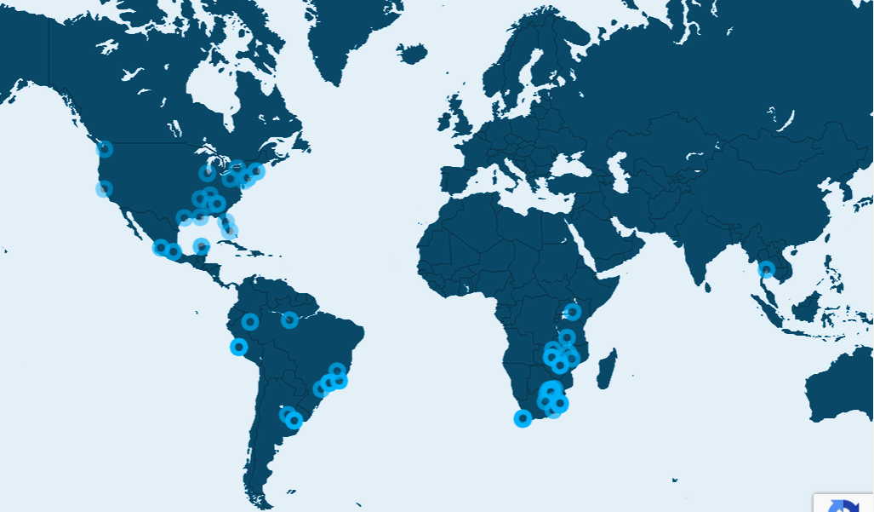



Slide 24
Q & A

