Slide 1
Statistical Considerations in Planning and Conduct of Dose Optimization Trials
Ying Yuan, PhD
Bettyann Asche Murray Distinguished Professor
The University of Texas MD Anderson Cancer Center

Slide 2
Project Optimus
In 2022, FDA OCE initiated Project Optimus “to reform the dose optimization and dose selection paradigm in oncology drug development.”

Slide 3
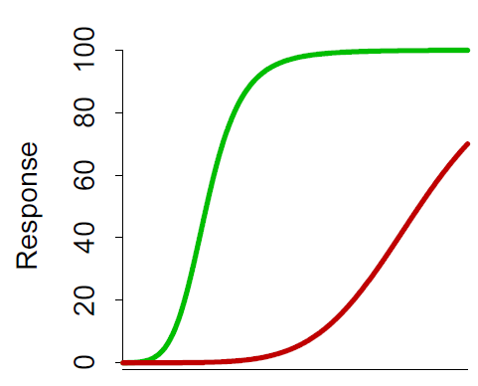
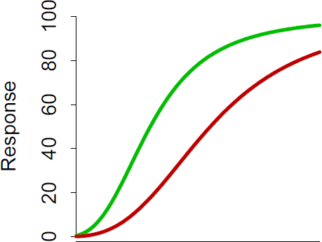
Paradigm shifting from MTD to OBD
Cytotoxic Chemotherapy
Targeted Therapies
Narrow Therapeutic Index
Wide Therapeutic Index
Efficacy Toxicity
Efficacy
Toxicity
Toxic
Toxic
Dose
MTD ≈ OBD
Dose
OBD MTD
MTD-based dose finding is often appropriate
Safety alone will not inform optimal RP2D
MTD: maximum tolerated dose. OBD: optimal biological dose

Slide 4
MTD vs. OBD
MTD
 | d1 | d2 | d3 | d4 | d5
Pr(toxicity) | 0.08 | 0.12 | 0.3 | 0.45 | 0.55
Pr(efficacy) | 0.30 | 0.50 | 0.51 | 0.51 | 0.52
Optimal biological dose (OBD)

Slide 5
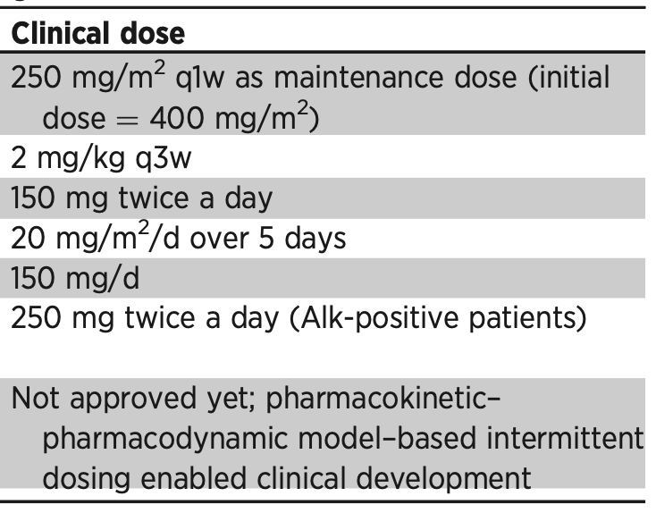
*
*Up to 500 mg/m²
Sachs, et al., (2015) Clin Cancer Res; 22(6) 1-7

Slide 6
Design strategies to find OBD
(A) Efficacy-integrated dose-finding strategy
Incorporate efficacy to guide dose escalation
Conventional designs guide dose escalation solely based on toxicity
Continuously update the estimate of the desirability (i.e., risk-benefit trade-off) of each dose to guide dose escalation
4
Dose Level
3
2
1
Accrual

Slide 7
Design strategies to find OBD
(B) Two-stage dose-finding strategy
based on toxicity

Slide 8
(A) Efficacy-integrated dose-finding strategy

Slide 9
Risk-benefit trade-off
Utility-based approach
Let $u_{1}, …, u_{4}$ denote the score ascribed to, and $π_{1}, …, π_{4}$ denote the probabilities of the four possible outcomes
The desirability (or mean utility) of a dose is given by
$U=u_{1}π_{1}+$ $u_{2}π_{2}+$ $u_{3}π_{3}+$ $u_{4}π_{4}$
Toxicity | Response
 | No (Y_{E} = 0) | Yes (Y_{E} = 1)
No (Y_{T} = 0) | $u_{2}=4$0 | $u_{1}$= 100
Yes (Y_{T} = 1) | $u_{4}=$ 0 | $u_{3}=6$0

Slide 10
MTD vs. OBD
Revise the example:
Pr(toxicity) = (0.08, 0.12, 0.30, 0.45, 0.55)
Pr(efficacy) = (0.30, 0.50, 0.51, 0.51, 0.52)
Desirability = (54.8, 65.2, 58.6, 52.6, 49.2)
MTD
Dose d = 2 is the OBD

Slide 11
Advantages of utility approach
Easy to communicate: clinicians understand clinical outcomes better than probabilities
Flexible: contain marginal-probability-based approach as a specifical case when setting $u_{2}+u_{3}=100$ (Zhou et al., 2019; Lin et al., 2020):
Toxicity | Response
 | No (Y_{E} = 0) | Yes (Y_{E} = 1)
No (Y_{T} = 0) | $u_{2}=4$0 | $u_{1}$= 100
Yes (Y_{T} = 1) | $u_{4}=$ 0 | $u_{3}=6$0
Equivalent to $U=π_{E}−\frac{2}{3}π_{T}$

Slide 12
Advantages of utility approach
Easy to communicate: clinicians understand clinical outcomes better than probabilities
Flexible: contain marginal-probability-based approach as a specifical case when setting $u_{2}+u_{3}=100$ (Zhou et al., 2019; Lin et al., 2020):
Toxicity | Response
 | No (Y_{E} = 0) | Yes (Y_{E} = 1)
No (Y_{T} = 0) | $u_{2}=$0 | $u_{1}$= 100
Yes (Y_{T} = 1) | $u_{4}=$ 0 | $u_{3}=10$0
Equivalent to $U=π_{E}$ (select most effective dose)

Slide 13
Advantages of utility approach
Scalable: more than two levels for each endpoint, and more than two endpoints (Liu et al., 2018)
Toxicity | Response
 | No (Y_{E} = 0) | Yes (Y_{E} = 1)
Low (Y_{T} = 0) | $u_{2}=4$0 | $u_{1}$= 100
Moderate (Y_{T} = 1) | $$u_{4}=20$$ | $u_{3}=7$0
Severe (Y_{T} = 2) | $u_{6}=$ 0 | $u_{5}=5$0

Slide 14
Efficacy-integrated dose finding
Collect efficacy and toxicity data
Treat the first cohort at the starting dose
Treat the next cohort of patients at the recommended dose
Update the estimate of desirability for each dose based on interim data
Determine dose escalation/de-escalation based on the estimated desirability
Model-based approach
Model-assisted approach

Slide 15
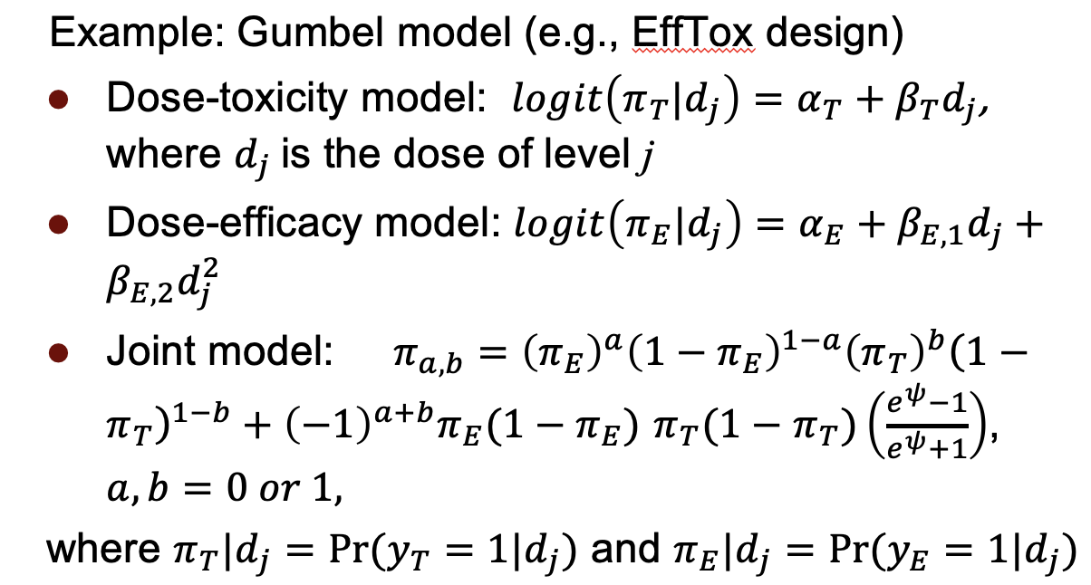
Model-based approach
Assume a statistical model describing dose-toxicity and dose-efficacy relationships
Often complicated
Examples: EffTox (Thall and Cook, 2004), Late-onset EffTox (Lo-EffTox, Jin et al., 2014)
Pros: accounts for risk-benefit tradeoff, highly flexible
Cons: complicated to implement, requires real-time model estimation, subject to the influence of model misspecification

Slide 16
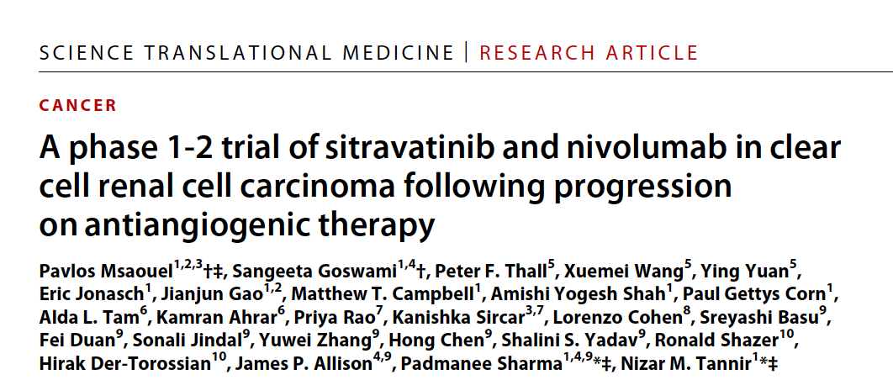
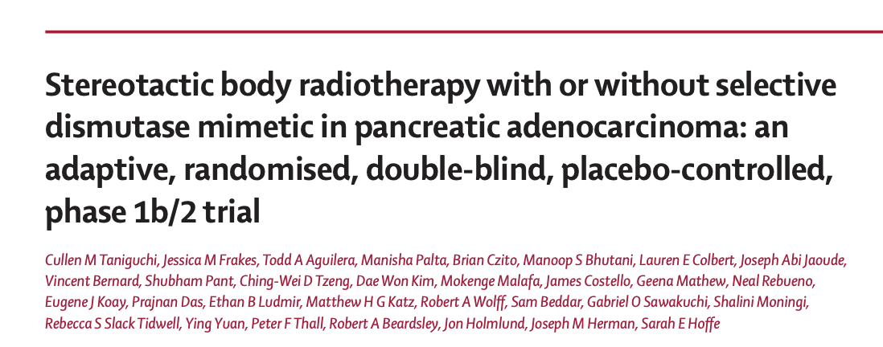
Trial examples
Dose optimization trials based on the Lo-EffTox design (Jin et al., 2014)
Jin IH, Liu S, Thall PF, Yuan Y. Using Data Augmentation to Facilitate Conduct of Phase I-II Clinical Trials with Delayed
Outcomes. J Am Stat Assoc. 2014;109(506):525-536.

Slide 17
A pancreatic cancer trial
LO-EffTox design
Tidwell RSS, Thall PF, Yuan Y. (2021) JCO Precis Oncol. 1719-1726. doi: 10.1200/PO.21.00212.

Slide 18
Model-assisted approach: BOIN12
$$≤λ_{e}$$
Compute the DLT rate
at current dose j
$$>λ_{d}$$
Within $(λ_{e},λ_{d})$
$$<6$$
Count the number of
patients at dose j
$$≥6$$
Choose a dose from
$\{j−1,j,j+1\}$
using the RDS table
Choose a dose from
$\{j−1,j\}$
using the RDS table
De-escalate the dose to
$j−1$
* RDS: rank-based desirability score, see next page
Lin R, Zhou Y, Yan F, et al. BOIN12: Bayesian optimal interval phase I/II trial design for utility-based dose finding in immunotherapy and targeted therapies. JCO Precis Oncol 2020; 16: 1392–1402.

Slide 19
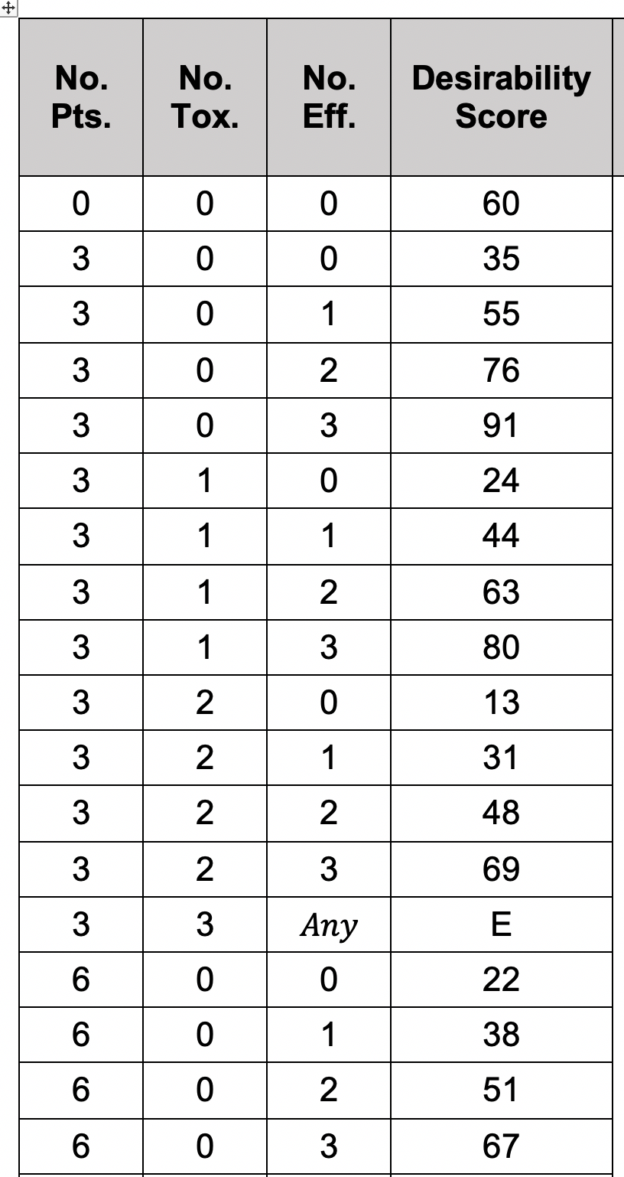
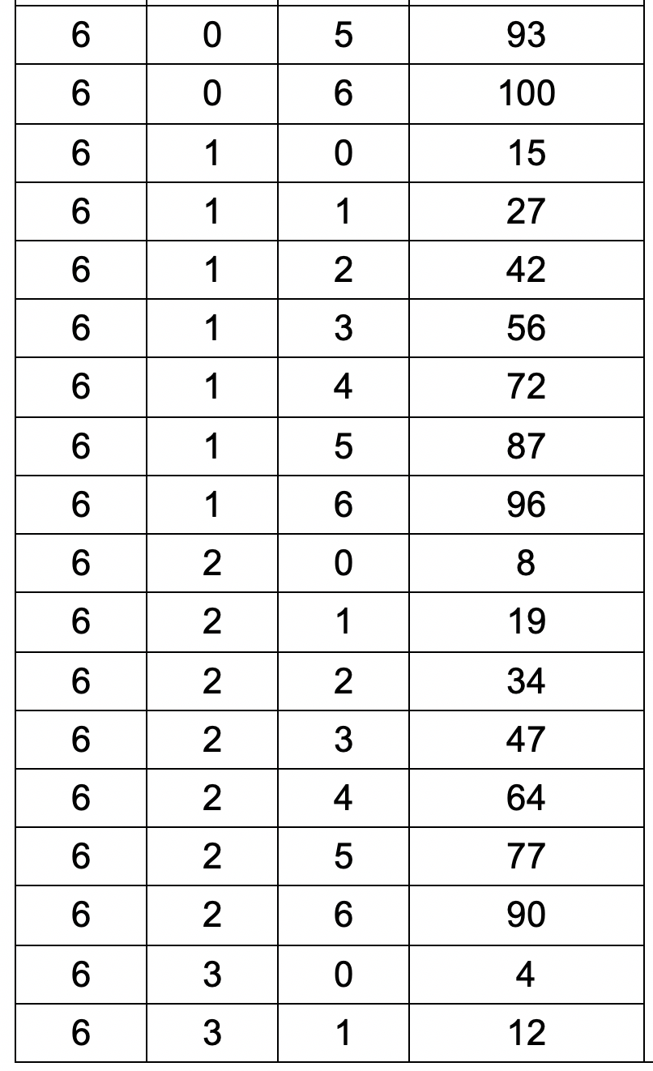
Rank-based desirability score (RDS)

Slide 20
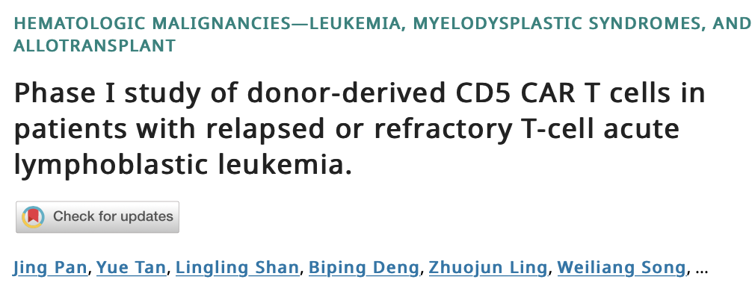
Applications
BOIN12 (NCT04835519, NCT05032599)
Phase I/II Study of Enhanced CD33 CAR T Cells in Subjects With Relapsed or Refractory Acute Myeloid Leukemia
Donor-Derived CD5 CAR T Cells in Subjects With Relapsed or Refractory T-Cell Acute Lymphoblastic Leukemia

Slide 21
(B) Two-stage dose-finding strategy

Slide 22
Two-stage dose-finding strategy

Slide 23
Example 1: U-BOIN
Identify
admissible doses*
BOIN/BOIN12
design
Randomize and select
OBD based on utility
Interims
Adaptively drop futile or toxic doses based on BOP2 design
*doses are safe with promising antitumor activities
Zhou Y, Lee JJ, Yuan Y. (2019) A utility-based Bayesian optimal interval (U-BOIN) phase I/II design to identify the optimal biological
dose for targeted and immune therapies. Stat Med., 38(28):5299-5316.

Slide 24
Take advantage of backfill
Identify
admissible doses*
Randomize and select
OBD based on utility
BOIN design
Interims
Backfill
Adaptively drop futile or toxic doses based on BOP2 design
*doses are safe with promising antitumor activities
BOP2: Bayesian optimal phase 2 design
Zhou Y, Lee JJ, Yuan Y. (2019) A utility-based Bayesian optimal interval (U-BOIN) phase I/II design to identify the optimal biological
dose for targeted and immune therapies. Stat Med., 38(28):5299-5316.

Slide 25
Objectives of backfill
To streamline the early phase of drug development by collecting more safety and activity data at multiple dose levels to inform the selection of the RP2D (i.e., dose optimization)
Aligns with FDA guidance “The trial should be sized to allow for sufficient assessment of activity, safety, and tolerability for each dosage.”
Backfilling also greatly improves patient access to the trial by increasing the availability of patient slots

Slide 26
Issues of backfill
Despite its increasing use in practice, trial protocols rarely provide sufficient details regarding backfilling to cover trial contingencies and support the interpretation of the study results.
For example, under what condition backfill will commence and stop?
If excessive toxicity is observed during backfilling, should the dose escalation be adjusted to account for the toxicity data that emerged from the backfilling?
How does backfill impact the operating characteristics of the dose-finding design?

Slide 27
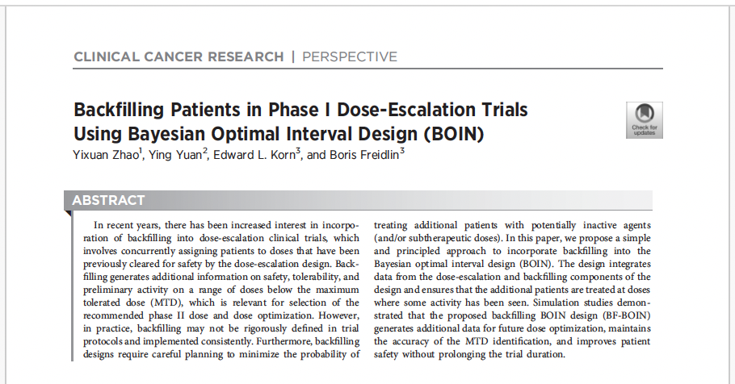
Backfill during dose escalation

Slide 28
Applications
U-BOIN (NCT05334329)
Genetically Engineered Cells (COH06) With or Without Atezolizumab for the Treatment of Non-small Cell Lung Cancer Previously Treated With PD-1 and/or PD-L1 Immune Checkpoint Inhibitors

Slide 29
Comparison of two strategies
 | Efficacy-integrated Strategy | Two-stage Strategy
Pros | Highly efficient and thus small n Explicitly account for risk-benefit tradeoff Continuously update the OBD estimate in light of accrued data throughout the trial (fully adaptive !) | Conceptually simple Randomization (if possible) allows unbiased comparison (but may be limited) Better accommodate late-onset endpoints (e.g., efficacy, tolerability)
Cons | Conceptually more complicated More challenging to handle late-onset endpoints (TITE-BOIN12 alleviates this issue) Assume a similar indication in phase II | Relatively larger n Doses selected to stage 2 may be wrong (due to small n in stage 1) and lack of a mechanism to correct it May unnecessarily escalate the dose to high and potentially toxic levels
Hybrid approach: Efficacy-integrated stage 1 + Stage 2 randomization !

Slide 30
www.trialdesign.org

Slide 31
www.trialdesign.org

Slide 32
BOIN Suite

Slide 33
BOP2 Suite

Slide 34
Reference
Yuan Y., Zhou H, Liu S (2024) Statistical and practical considerations in planning and conduct of dose-optimization trials, Clinical Trials, https://doi.org/10.1177/17407745231207085

